Slide 1
February
2024
Monthly Broker Slides

Slide 2
Celebrate Black History Month
Succeedwithmore.com/photofy
Representation Matters – Episode 1
Membership Drive – Illinois Association of Black Real Estate Professionals
Black History Month Feature: What Black History Month (BHM) Means to Mainstreet? – Mainstreet Buzz Blog
Download the SHIBA report, courtesy of the National Association of Real estate Brokers. Use this report to understand the issues that impact and impede Black families from realizing the dream of homeownership.

Slide 3
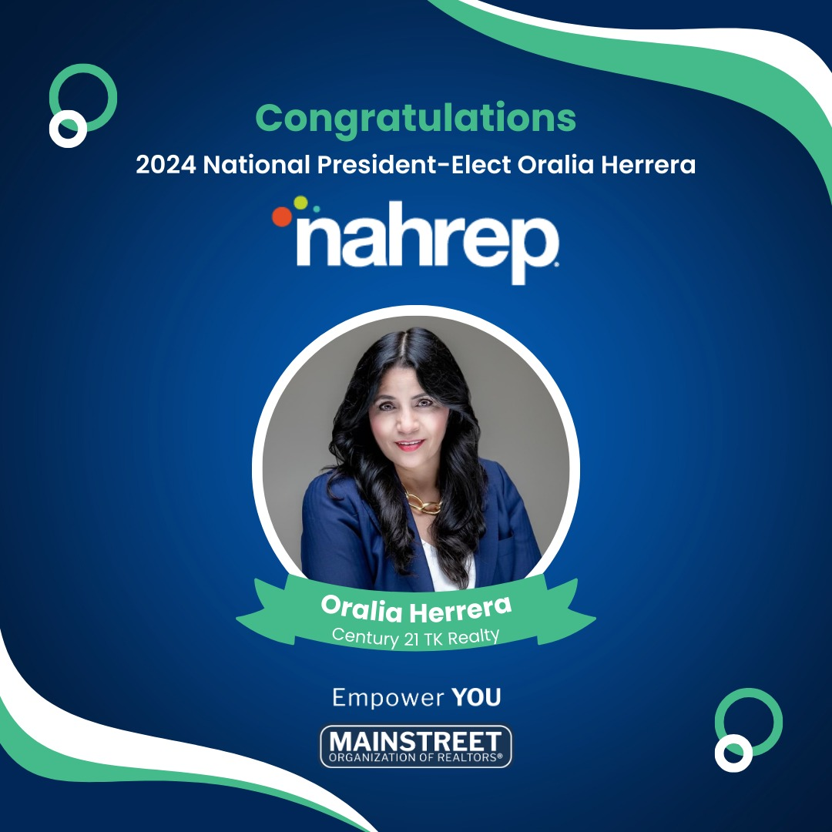
Congratulations
Mainstreet Organization of REALTORS® is extremely proud to announce that Oralia Herrera — Century 21 TK Realty — has been selected as the next President-Elect of the National Association of Hispanic Real Estate Professionals (NAHREP.)
A Mainstreet Member for over 34 years, Oralia has been a shining star in the real estate industry and a trailblazer in her community. Her passion, commitment to service and professional expertise have left an incredible mark on the real estate landscape. She made history as the NAHREP DuPage Founding President, breaking barriers and paving the way for others. Now, she’s set to embark on an even greater journey as a NAHREP National Leader, advancing sustainable Hispanic homeownership.
Please join the Mainstreet Board of Directors in saluting Oralia’s inspirational leadership and our best wishes for continued success!

Slide 4
Do you know someone under 40 who demonstrates excellence in their careers, community and real estate industry? Tell us more!
Must be a primary or secondary REALTOR® member of Mainstreet
Forty years or younger on June 1, 2024
2024 APPLICATION

Slide 5
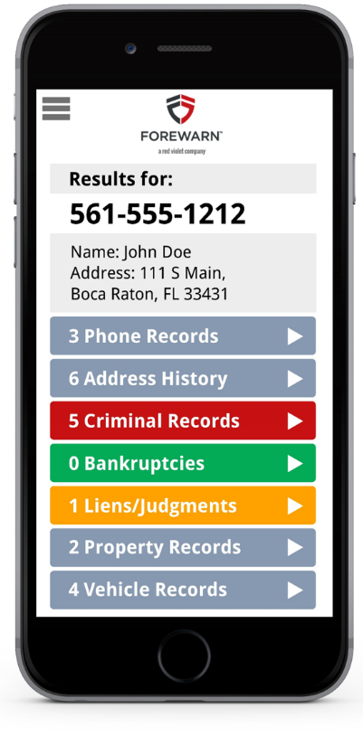
Member Benefit - FOREWARN
FOREWARN enhancements that prioritize safety while enabling members to best serve their prospects and customers. New features include:
Deceased Indicator – Users can reference the deceased indicator to help assess whether a prospect may be misappropriating the identity of a deceased person.
Emailed Prospect Report – With one click users can now instantly email themselves a prospect report PDF to reference later.
Foreclosures, Liens, and Judgments – Users now have a broader history of customer details to help better understand and address their prospect's needs.

Slide 7
Capitol Conference
Register:
Downers Grove
Rolling Meadows
Tinley Park
No Bus

Slide 8
Upcoming Courses & Events
March
Certified Staging Consultant
CSC+ an Accessorizing Workshop for REALTORS
Boost: Unlocking Success in Buyer Agency
Essential Buyer and Seller Conversations
Protecting Your Practice: NAR Lawsuits and Strategies
Bias Override: Overcoming Barriers to Fair Housing
Marketing Strategies for the Senior Real Estate Specialist
Rebooting Seller Strategies and Conversations
Rebooting Buyer Strategies and Conversations
Commercial Boot Camp
45 Hour Post Licensing
YPN Connect
Coffee & Conversation: Own Who You R: Celebrating Women in Real Estate

