Slide 1
January 2024
Monthly Designated Managing Broker Slides

Slide 2
New Laws in 2024
Renting and selling to migrants: Landlords will be required to rent or sell property to non-citizen migrants. The law also adds immigration status as a protected class (Effective 1.1.2024).
Complete list of new laws (2024)
Illinois REALTORS® Video

Slide 3
Professional Standards
Missed the latest Coffee & Conversation webinar? No worries we have you covered, watch the recording HERE.
This webinar showcases experts in the REALTOR® Code of Ethics, unveiling ‘did you know?’ facts, demystifying the intricacies of forms and contracts, and honing the skill of effective communication with agents and clients.

Slide 4
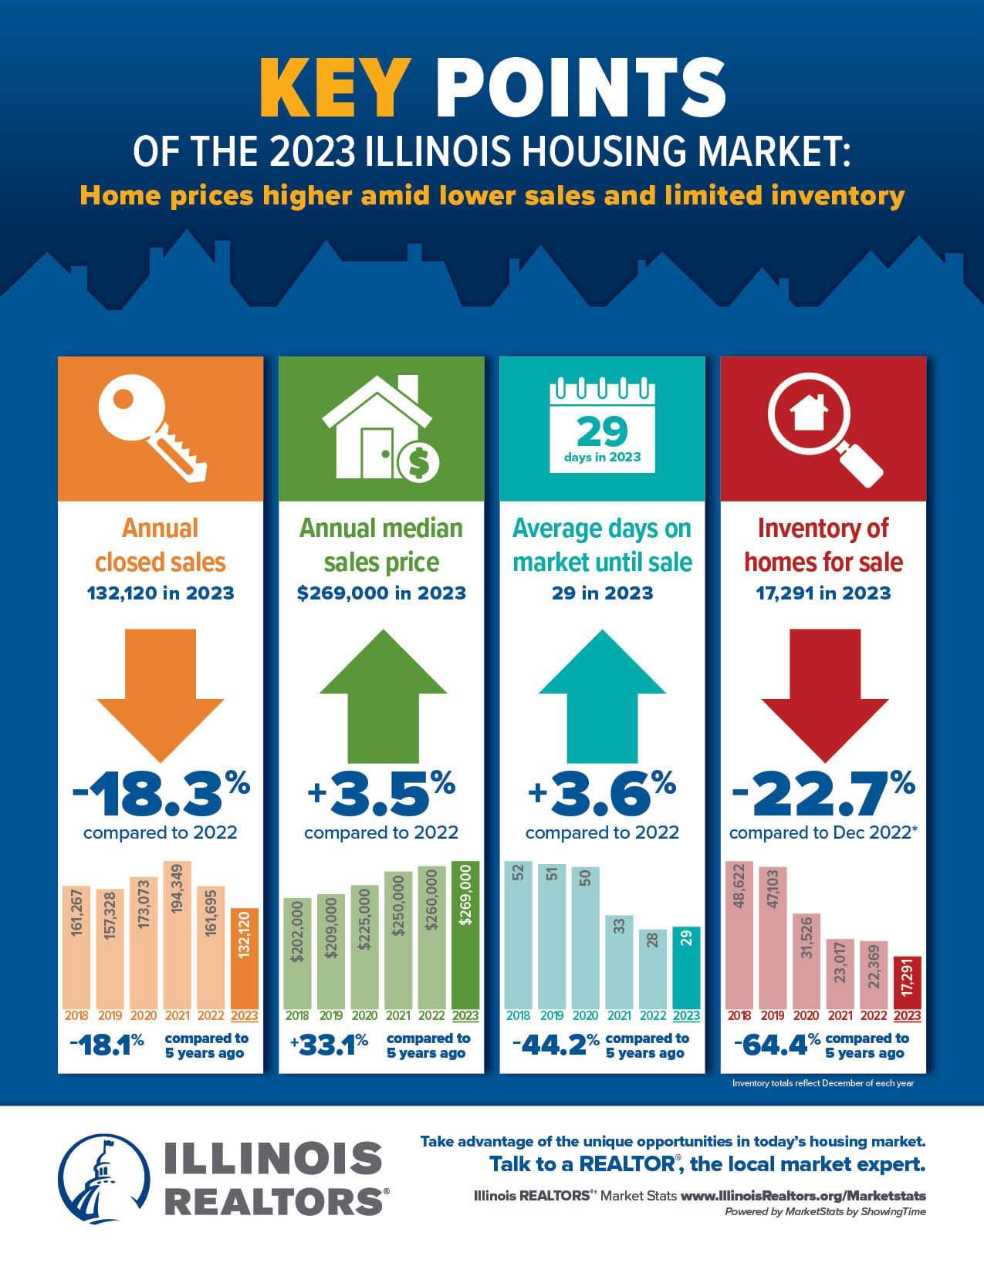
Home prices in Illinois were higher amid lower sales and limited inventory in 2023.
Download and share the Illinois REALTORS® 2023 Annual Report and Infographic HERE.

Slide 5
Member Benefit – Tech Helpline
There's no need to sign up for anything, your account is attached to your active Mainstreet REALTORS® membership and is ready to be used when you need it. When you need assistance, the process is simple:
Contact Tech Helpline via phone, live chat or email.
They’ll verify your active Mainstreet REALTOR® membership.
They’ll troubleshoot the problem or provide answers to your questions.

Slide 6
Upcoming Courses & Events
February
Seller Representative Specialist (SRS)
Boost Session 3 - Zoom
Bis Override: Overcoming Barriers to Fair Housing
Pricing Strategy Advisor (PSA)
Brokerage Forum
Economic Outlook – Signature Event
Rebooting Seller Strategies and Conversations
Rebooting Buyer Strategies and Conversations
45 Hour Post Licensing – Saturday Classes via Zoom
Spokesperson Training
Accredited Buyers Representative ABR
Leadership Academy – Signature Event

