Slide 1
Addressing Housing Challenges Experienced by Refugees
David Zverow
Program Consultant
Chair, RAN Housing Committee

Slide 2
Mission: Refugee Action Network is a statewide advocacy group supporting the inclusive integration of refugees in Illinois through public policy and community education.
About us: We are a coalition of refugees, resettlement agencies, mutual aid societies, community organizations, and other advocates working together to advocate for refugees, asylees, asylum-seekers, and those with similar status.
Formerly named The Golden Door Coalition, we’ve advocated for refugees in Chicago and throughout Illinois for more than a decade. We are committed to creating welcoming communities that value refugees and empower them to lead fulfilling lives of safety and dignity.
Refugee Action Network’s work focuses on:
Creating an inclusive network that uplifts the voices of refugees
Educating communities, civic leaders, and the media about refugees
Mobilizing individuals and organizations to advocate for refugees

Slide 3
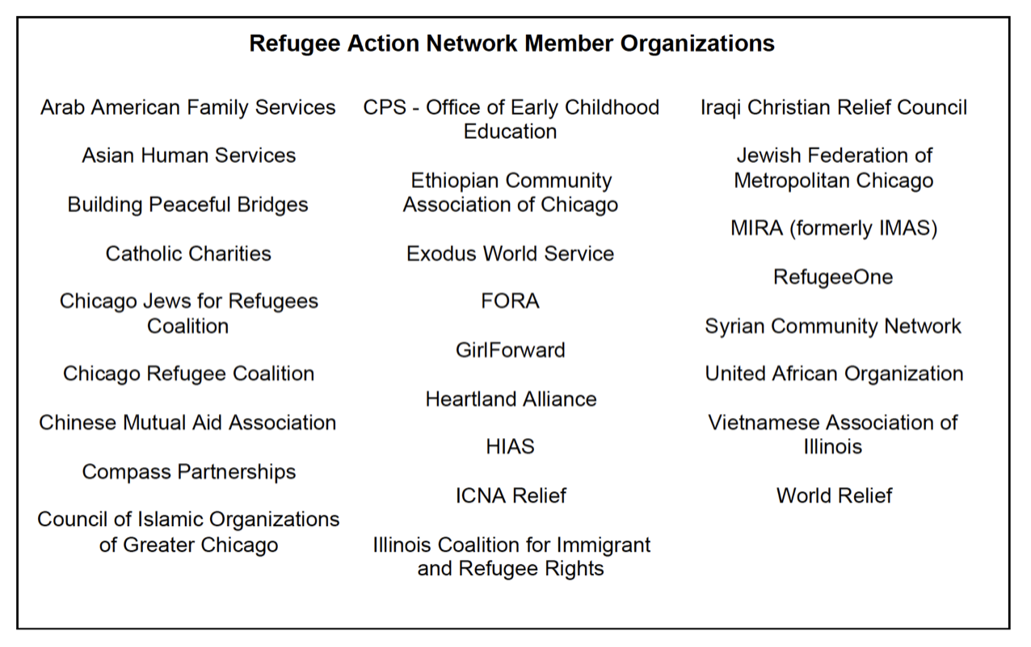

Slide 4
RAN Housing Committee Activity
Refugee Action Network
Origin and activity of Housing Committee
Partnership with Housing Action Illinois
State advocacy:
HB 2775-Source of Income discrimination prevention
$150M in American Rescue Plan Act funds for affordable housing
Federal advocacy:
Legislator visits for Build Back Better Act
Municipal advocacy:
Meet with mayors and/or housing officials in designated suburbs

Slide 5
Refugee Resettlement Flow Chart
1. Oversees United Nations and U.S. vetting of refugee family
Families often wait years for resettlement from refugee camps
Most Afghan and Ukrainian families come in as parolees, not refugees
Parolees are not guaranteed benefits by the U.S., just emergency placement
Afghans, Ukrainians are granted most refugee benefits
Asylees proceed through a different process
2. Resettlement agencies in placement city⇆Government agencies
Three months of government services are mandated. Sometimes service period is extended.
Chicago area resettlement agencies: Refugee One, Ethiopian Community Association, World Relief, Heartland Alliance, Catholic Charities, JCFS (HIAS Chicago), Muslim Women’s Center, Arab-American Family Services
Resettlement agencies are responsible for finding families housing, jobs, and applying for benefits
3. Mutual aid societies/local independent agencies
ICNA Relief, Building Peaceful Bridges, Compass in this category
Provide wide variety of case management and other services in languages of most common refugee groups.

Slide 6
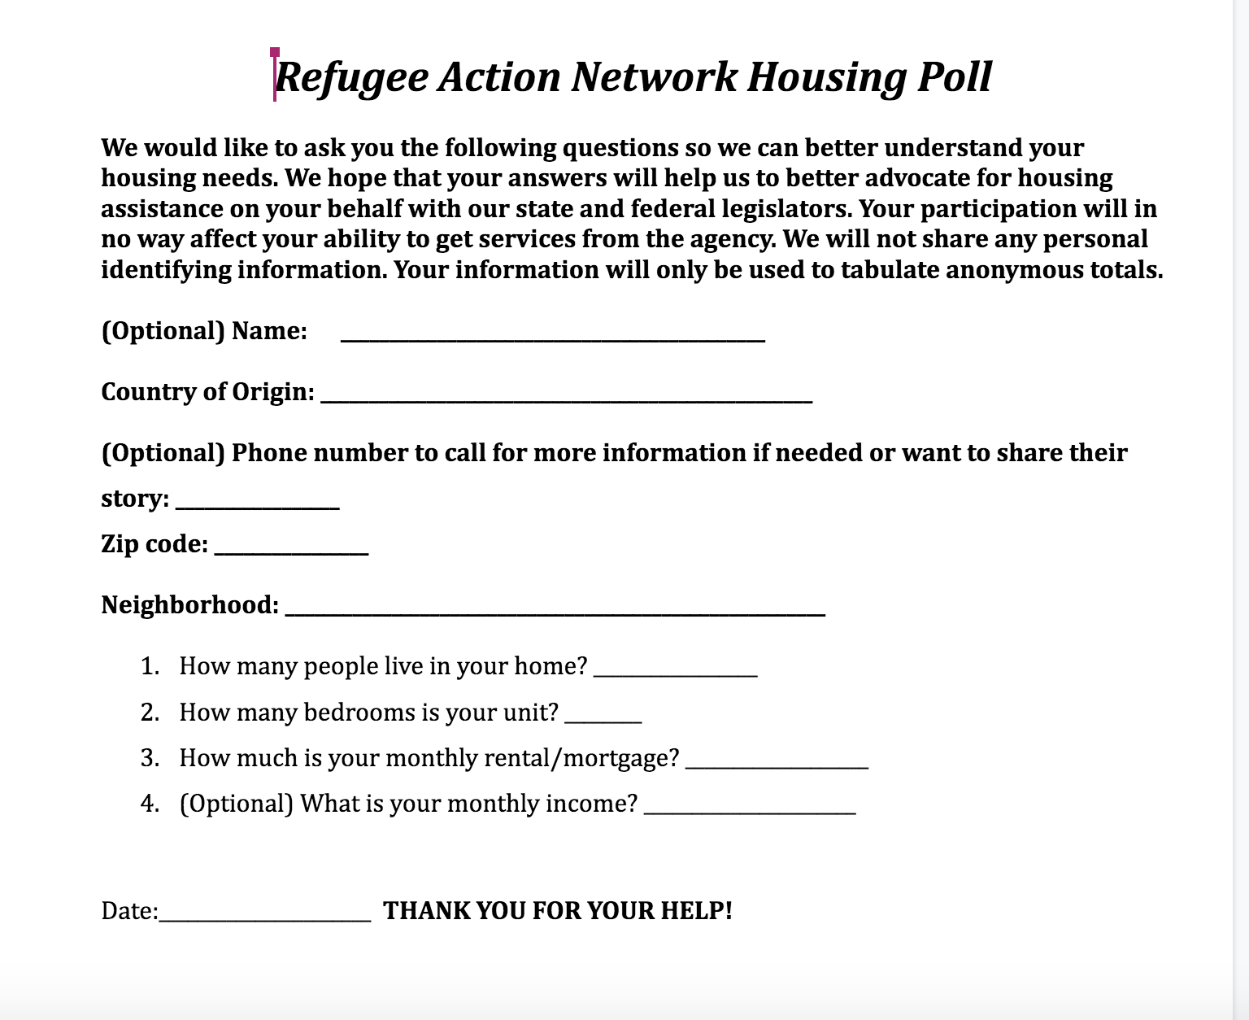

Slide 7
Refugee Action Network Housing Poll Results
Survey of housing data from 120 refugees from:
ICNA Relief
Refugee One
Arab American Action Network
World Relief
Average family rental cost $1,105
Average family income/mo $1,521
Percentage of family income spent on rent 73%

Slide 9
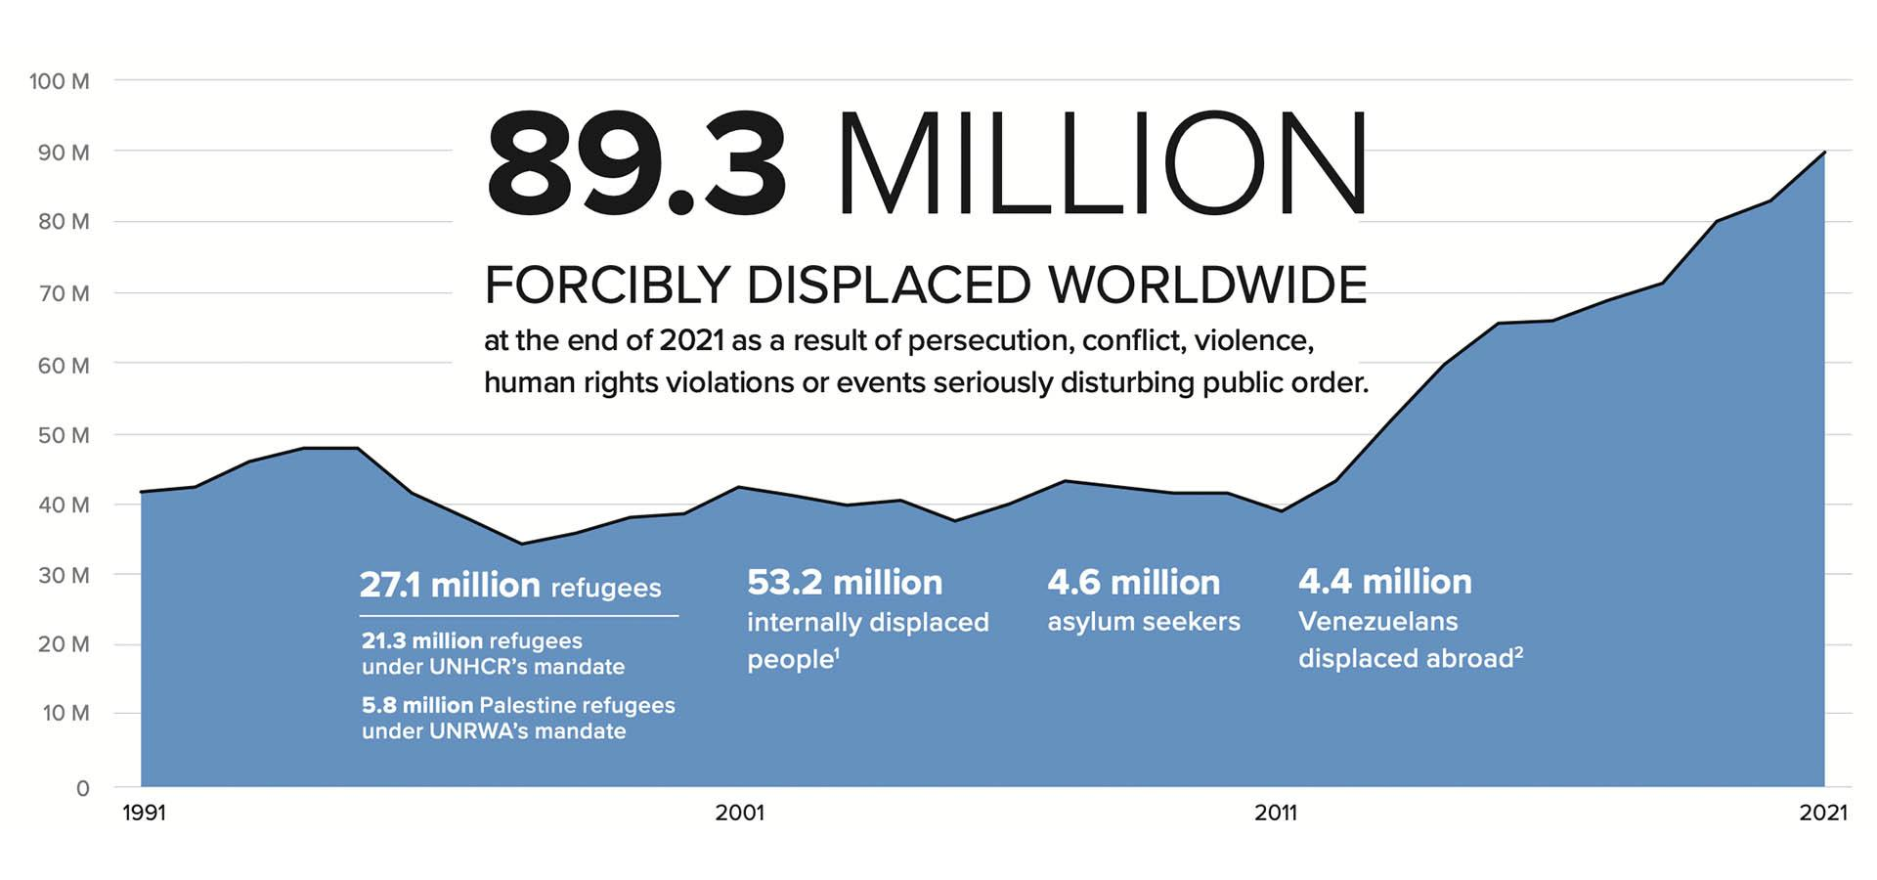
https://www.unhcr.org/ph/figures-at-a-glance

Slide 10
1st Country 2nd Country 3rd Country

Slide 11
ART 1: LEGAL RECOGNITION AS A REFUGEE
A REFUGEE IS SOMEONE WHO “OWING TO A WELL-FOUNDED FEAR OF BEING PERSECUTED FOR REASONS OF RACE, RELIGION, NATIONALITY, MEMBERSHIP OF A PARTICULAR SOCIAL GROUP, OR POLITICAL OPINION, IS OUTSIDE THE COUNTRY OF HIS NATIONALITY, AND IS UNABLE TO OR, OWING TO SUCH FEAR, IS UNWILLING TO AVAIL HIMSELF OF THE PROTECTION OF THAT COUNTRY...”
The 1951 Convention relating to the Status of Refugees

Slide 12
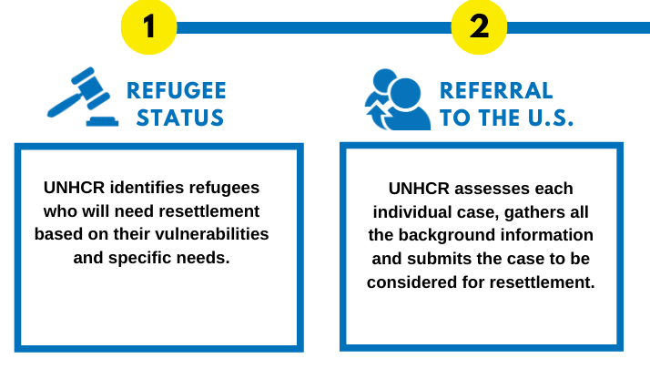
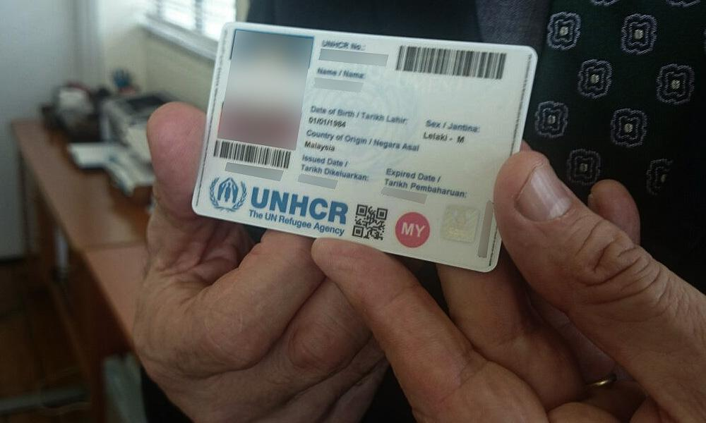
Do not choose country they would like to live
US Ties can increase odds of going to particular country
UNHCR identifies most vulnerable refugees for resettlement and makes recommendations to countries
Urgent protection cases
Single parent households
Women head of households
Chronic illness/significant medical needs
City Locations- go to local UNHCR offices and apply for status
Refugee Camps- register for status
UNHCR ID Card
Less than 1% of the world's refugees are resettled into a 3rd country

Slide 13
What does Refugee and Asylum Status provide?
Asylum Seeker
Asylee
Resettled Refugees
Work permit after 180 days if their case has not been heard
Immediate access to SS card and Work Permit
Immediate access to SS card and Work Permit
No formal status – limbo
Asylum for individual and family
Green Card after 1 year, May be granted citizenship in 5 years
Green Card after 1 year, May be granted citizenship in 5 years
No support (EU countries there is support)
Reception & Placement support services w/ a Refugee Agency (90 days)
Can be a 2-10 year process
May be eligible to receive help from ORR refugee agency
Notes:
Reception & Placement support services w/a Refugee Agency (90 days)
They get a green card
They have a Social Security card
Green Card after one year
Can be granted citizenship in 5 yea

Slide 14
Reception and Placement (R&P) Period
30 to 90 days
Core services with specific timelines
Designed to help with integration and obtaining self-sufficency

Slide 15
Preparing for Arrival
Agency
Participant
Receive Case Manager
Housing
Furniture, kitchen utensils, etc.
Food
Welcome meal- hot culturally relevant food
Culturally Relevant groceries
Spending Money
$200 per person
Planning Airport Reception
Cultural Orientation
Final Medical Screening
COVID-19 Test

Slide 16
Core Services Include...
Housing
Furnishings
Public Benefits
Health Screening
English Class
K-12 school enrollment
Employment Services
Social Security Card
State ID
Transportation
Home Visits (24 hr and 30 day)
Intake
Reception
Service Plan
Pocket Money
Selective Service
AR-11
Budget
Cultural Orientation

Slide 17
Refugee Agencies Overwhelmed with Housing Placement
Federal funds for other services have been diverted for pressing need of housing
Scrambling to house new arrivals
Hotels
Airbnb

Slide 18
Beyond Reception & Placement – Mutual Assistance/Aid Associations (MAA)
Historically ethnically based organizations to provide longer term support for refugee newcomers (Chinese Mutual Aid, Cambodian Mutual Aid, Iraqi Mutual Aid, Syrian Community Network)
Provide a range of services such as ESL, career training, citizenship preparation, child afterschool programs, legal aid, food pantry

Slide 19
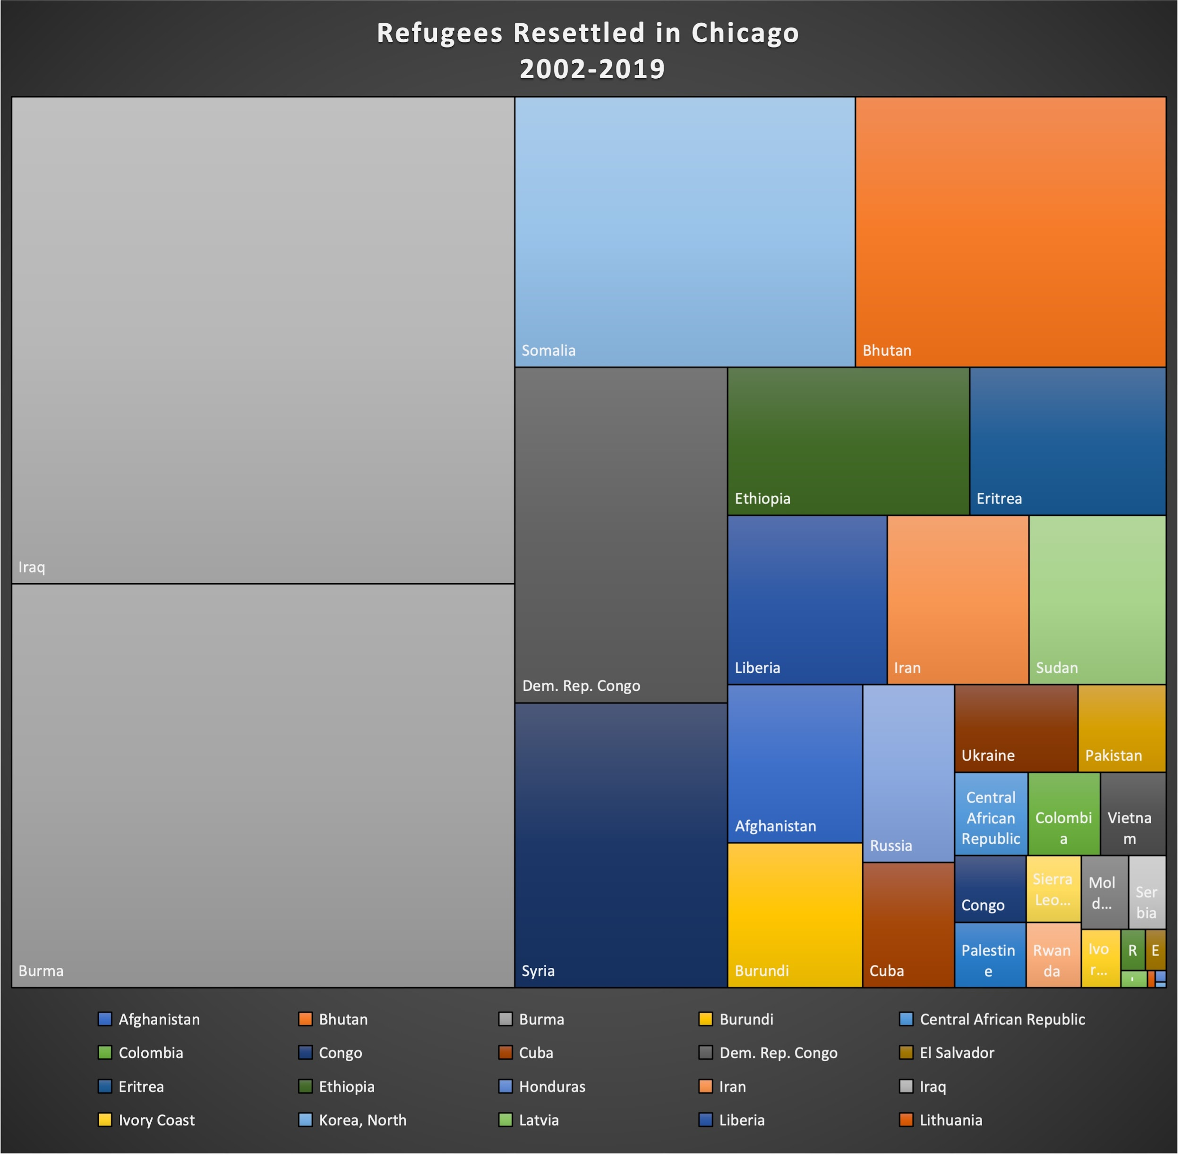
Chicago – 15,574 Refugees Resettled between 2002-2019

Slide 21
