Slide 1
Find the right direction for your estate plan
Disclosure: Information is provided for educational purposes only and is not intended as tax, legal, or financial advice, and should not be relied on as such. You are encouraged to seek tax, legal, or financial advice from appropriate professional(s), including an independent professional advisor and an attorney. Estate planning legal documents must be drafted by an appropriately licensed attorney..
Notes:
JENNIFER: SLIDES 1- 8
A majority of adult Americans believe having an estate plan is a good idea, but they don’t have one.
They’re most likely not in a hurry to act because they probably don’t understand fully what an estate plan can do for them and their family.

Slide 2
Notes:
JENNIFER
ANIMATION ON AUTOMATIC PLAY
In fact, when most people think about creating their estate plan, they probably start it like this… Give what I have, to whom I want, how I want it…
And although these points are true, an estate plan is so much more than this. It can provide exponentially more than most people realize.

Slide 3
THE BIG QUESTION:
WHAT DO I WANT MY ESTATE PLAN TO DO?
Notes:
JENNIFER
Before you start any estate planning, you must first understand your “why” – your primary reasons for creating an estate plan. If you don’t understand what is important to you, you won’t be setting up your estate plan to support it. Once you understand your “why,” then you’ll know what direction you should take.
You may not even know what you want your estate plan to do, so we’re going to help you discover those answers. We’re going to start by focusing on 3 primary problems you and your family could face.
Then we’ll show you how you can direct your estate plan to specifically address and be the solution to those challenges you most resonate with.

Slide 4
PROBATE
PROBLEM #1
Estate planning will happen: You either do it now or it will be done for you later.
Notes:
JENNIFER
The first major problem you may want your estate plan to take care of is probate
Probate is the legal process of administering your assets after your death
There’s a lot to probate, so we’re going to break it down into 3 areas to better understand its impact

Slide 5
WRONG BENEFICIARIES
INTESTATE:
THE COURT DETERMINES WHO GETS YOUR ASSETS ACCORDING TO THE STATE YOU LIVE IN.
PROBATE CONCERN #1
Notes:
JENNIFER
If someone dies without an estate plan in place, they die intestate – and what that means is that your state’s court will decide how your assets will be distributed.
In other words, you don’t decide who gets your stuff, your state laws do.
If someone is fine with this, there’s no problem. However, I think most people would consider this a problem, especially if they have family members with specific needs.

Slide 6
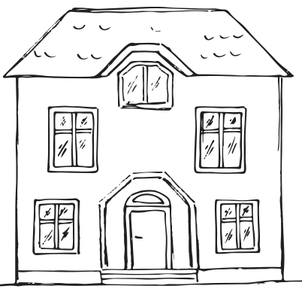
WRONG BENEFICIARIES
PROBATE CONCERN #1
Notes:
JENNIFER
You will most likely accumulate assets during your life. We’ll discuss these more fully later, but if you die without a will, trust or beneficiary designation for these assets, the state determines who gets them. So what does this look like:
Issue 1: State laws vary, but if you’re not married to your partner, they will not inherit any of your assets.
Story: One of our PZ staff members had this happen in her family. Her aunt was estranged from the family for decades and she had a partner she lived with in a house she owned. When she died, her partner received nothing. Ironically, the brother and sister she wanted no contact with were the legal heirs of her estate, and her partner had to stop living in the house. While probate was occurring for her property, her brother passed, so half of her estate went to her brother’s wife – someone she had never even met. If she had taken time to be sure her house and assets would be left to her partner, life would have resumed for him without the additional grief.
Issue 2: Someone may remarry and has children from the first marriage. You may want to leave your children specific distributions or assets from your estate, or maybe you want your spouse to have the house that’s titled in your name. In Illinois, intestate laws have half the assets you individually own go to your spouse and half go to your kids. That could be a problem depending on your situation.
Estate Planning Solution: You can direct your estate plan to specifically account for your unique family dynamic and distribute your assets exactly how you want.

Slide 7
Notes:
JENNIFER
If someone dies without an estate plan in place, they die intestate – and what that means is that your state’s court will decide how your assets will be distributed.
In other words, you don’t decide who gets your stuff, your state laws do.
If someone is fine with this, there’s no problem. However, I think most people would consider this a problem, especially if they have family members with specific needs.

Slide 8
TIME AND MONEY
TIME CONSUMING
6 months is minimum length
Typically, 1 to 2 years
Possibility of taking decades
MONEY CONSUMING
Possibly 3% to 7% of estate value or hourly attorney fees
Professional Fees
Court Fees
PROBATE CONCERN #2
Notes:
JENNIFER
Estate Planning Solution: You can direct your estate plan to avoid or minimize the time and expense of probate.
Even though a will goes through probate, if your estate plan is done correctly, probate will be a quicker and easier process for your family.

Slide 9
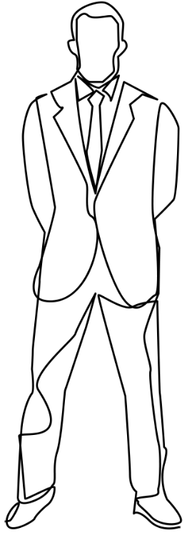
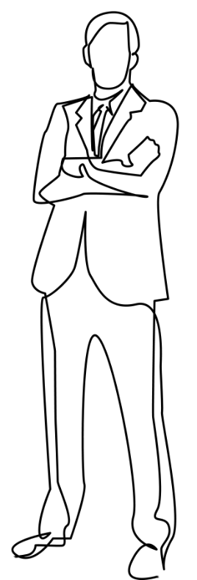
FAMILY DISPUTES
INHERITANCE
HEIRS
ATTORNEYS
PROBATE CONCERN #3
Notes:
JENNIFER
No estate plan or a poorly prepared estate plan can open the floodgate to contests and disputes. If someone feels entitled to an inheritance, or more of an inheritance, and begins litigation to get what they want, you are essentially deciding to leave a large part of your assets to the attorneys.
Interestingly, there are many families that don’t think this is going to be an issue because everyone gets along great. But the passing of a loved one can bring a lot of buried stuff to the surface. It’s wise not to chance it and save your family – sometimes from themselves.
Solution: You can direct your estate plan to avoid unnecessary family turmoil and protect your assets.

Slide 10
BENEFICIARY
CONCERNS
PROBLEM #2
Take a closer look at your beneficiaries. They could affect your estate plan.
Notes:
COURTNEY: SLIDES 9-17
People may be in the situation where they can approach their estate plan fairly straight forward: equal division among their children
However, not every situation is cut and dry. You may need a plan that addresses the needs of specific beneficiaries by setting up measures for protection in these following situations . . .

Slide 11
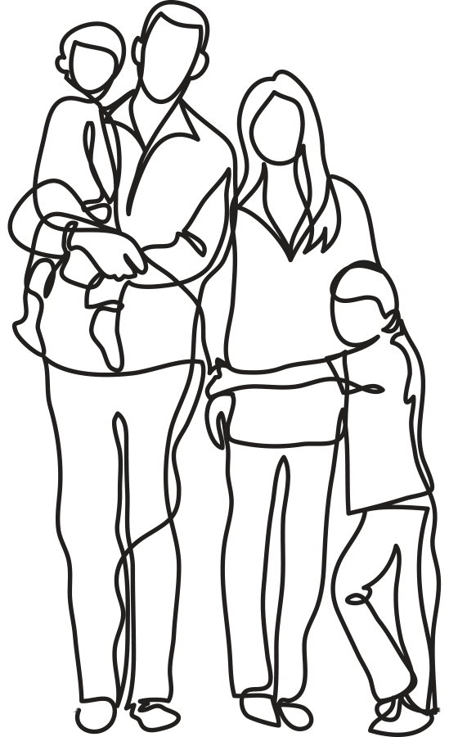
BENEFICIARIES
MEASURES FOR PROTECTION
GUARDIAN FOR MINORS
FOCUS ON SPECIAL NEEDS
BENEFICIARY CONCERNS
Notes:
COURTNEY

Slide 12
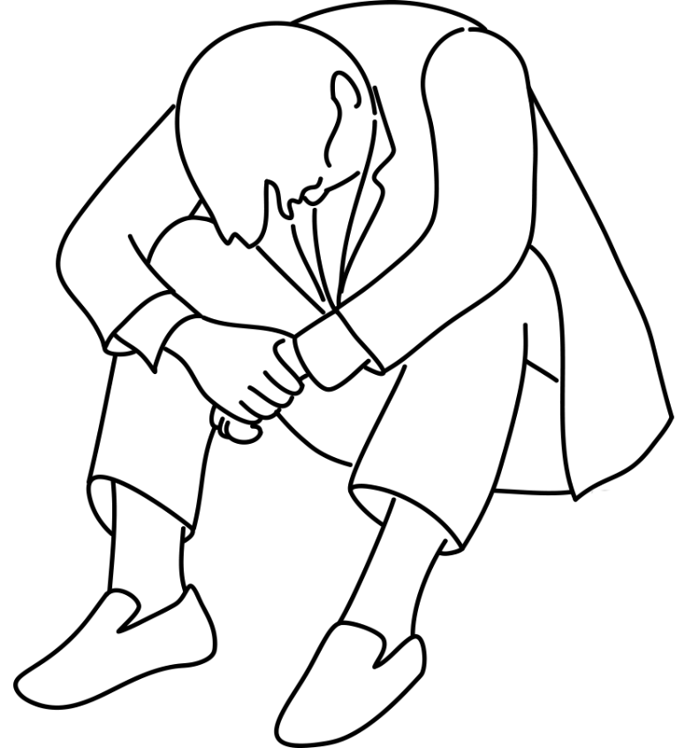
BENEFICIARIES
MEASURES FOR PROTECTION
PERSONAL CHALLENGES
MENTAL HEALTH
SUBSTANCE ABUSE
CREDITOR/DEBT ISSUES
BENEFICIARY CONCERNS
Notes:
COURTNEY

Slide 13
BENEFICIARIES
MEASURES FOR PROTECTION
PROFESSION (LAWSUITS)
HIGH INCOME TAX BRACKET
BENEFICIARY CONCERNS
Notes:
COURTNEY

Slide 14
BENEFICIARIES
MEASURES FOR PROTECTION
MARITAL CHALLENGES
Child’s spouse could get part of their inheritance in the event of divorce
BENEFICIARY CONCERNS
Notes:
COURTNEY

Slide 15
BENEFICIARIES
MEASURES FOR PROTECTION
GRANDCHILDREN
Leave a legacy
Help offset college costs
BENEFICIARY CONCERNS
Notes:
COURTNEY
Solution: a properly prepared estate plan will address and provide for all these beneficiary concerns

Slide 16
INCAPACITATION
PROBLEM #3
Your estate plan should take care of you while you’re still living.
Notes:
COURTNEY

Slide 17
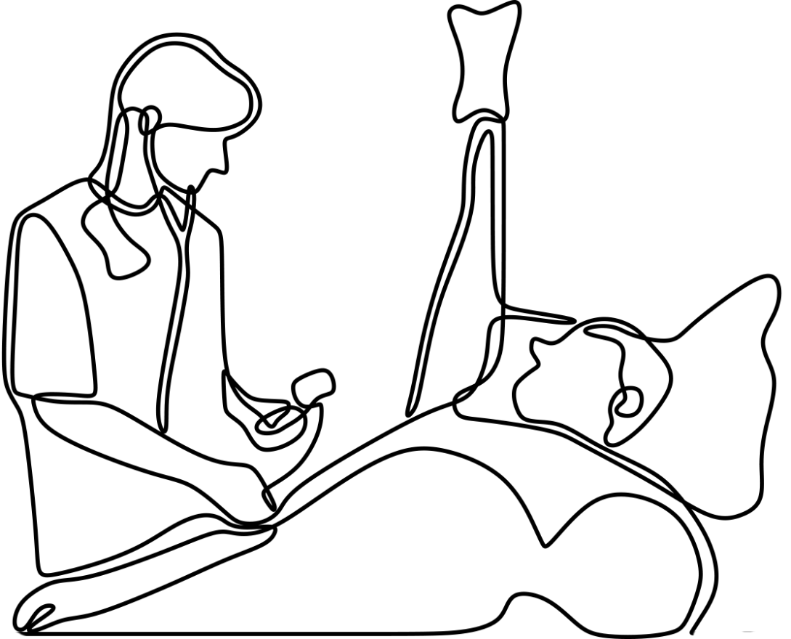
INCAPACITATION
PHYSICAL INCAPACITATION
WHO MAKES YOUR MEDICAL DECISIONS?
WHO HANDLES YOUR FINANCIAL AFFAIRS?
INCAPACITATION CONCERNS
Notes:
COURTNEY
What happens to you if you don’t have estate planning documents in place, and you end up in ICU on ventilators or life-support equipment, unable to make medical decisions for yourself or take care of your finances. Who will make your medical decisions for you? Who will take care of your bills while you’re hospitalized? In fact, due to advances in medicine/technology, more people go through incapacitation before they die.
If you don’t have necessary documents in place, your family will have to pursue an emergency guardianship through the courts, and this process can be expensive – especially if they have to go through an attorney.

Slide 18
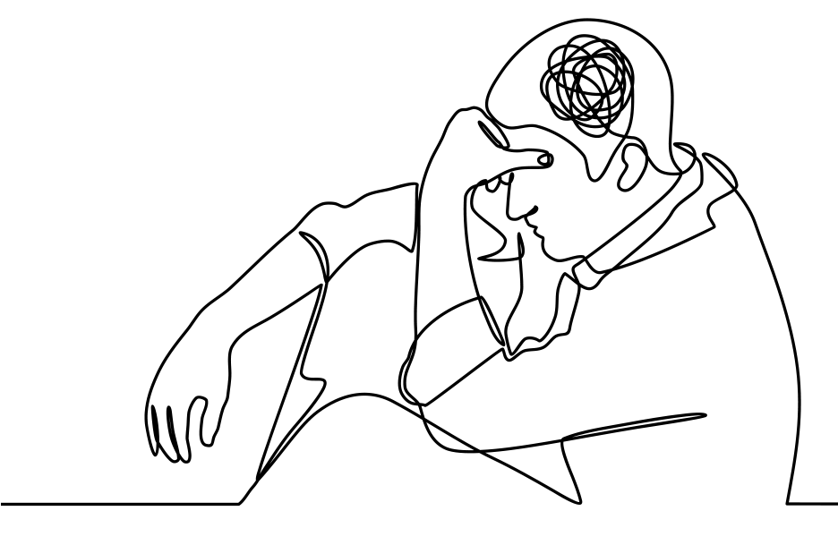
INCAPACITATION
MENTAL INCAPACITATION
LIVING PROBATE:
Guardianship Proceedings
Time Consuming
Expensive
Embarrassing
INCAPACITATION CONCERNS
Notes:
COURTNEY
If you don’t have necessary documents in place, your family will have to pursue guardianship proceedings through the courts. As our population is aging, mental incapacitation is growing due to Alzheimer’s/dementia
Solution: A comprehensive estate plan allows you to decide who will make your medical decisions for you exactly how you want them to, and you will decide who will handle your financial affairs when you finally need them to.

Slide 19
Finding the right solution for potential problems
Disclosure: Information is provided for educational purposes only and is not intended as tax, legal, or financial advice, and should not be relied on as such. You are encouraged to seek tax, legal, or financial advice from appropriate professional(s), including an independent professional advisor and an attorney. Estate planning legal documents must be drafted by an appropriately licensed attorney..
Notes:
JENNIFER
We’ve only hit some of the potential issues that could occur without a proper estate plan, but now we’re going to talk about the solutions.

Slide 20
WILL
CHOICES FOR
SUCCESSFULLY
TRANSFERRING YOUR ASSETS
LIVING TRUST
TRANSFERRING ASSETS
BENEFICIARY
DESIGNATIONS
Notes:
JENNIFER

Slide 21
____________________
BUILDING YOUR ESTATE PLAN WITH A SIMPLE WILL
Notes:
JENNIFER

Slide 22
Cost-effective estate plan if all assets are set up to avoid probate
THE ADVANTAGE OF WILLS
Create orderly transfer of assets by clearly stating to whom assets should be distributed
THE SIMPLE WILL
Protect rights of creditors and beneficiaries if going through probate
Notes:
JENNIFER
Can set up to avoid probate with beneficiary designations, Transfer on Death Deeds, joint ownership – we’ll discuss these later

Slide 23
FULLY PUBLIC
THE PROBLEM WITH
WILLS
GUARANTEE PROBATE
THE SIMPLE WILL
EASILY CHALLENGED
BY HEIRS
DIFFICULT TO CROSS
STATE LINES
Notes:
JENNIFER
Probate: We spoke earlier about the issues you will face with probate

Slide 24
_________________
Building an estate plan with a living trust
Notes:
JENNIFER

Slide 25
LEGAL ENTITY THAT CAN OPERATE INDEFINITELY
THE ADVANTAGE OF LIVING TRUSTS
ASSETS ARE OWNED BY THE TRUST
THE LIVING TRUST
UPON DEATH OR INCAPACITY, IT CONTINUES TO OPERATE BASED ON YOUR DIRECTIONS
AVOIDS PROBATE
Notes:
JENNIFER
A Living Trust is created while you are living – unlike a will, it operates while you’re alive and after you pass; you can amend or revoke it at any time while you’re alive, once you pass it becomes irrevocable – can’t be changed
Title to assets are transferred to the name of the trust “John Smith Living Trust”
Based on what you put in trust
It’s a separate legal entity. When you fund the trust, it owns the assets, not you

Slide 26
CREATES AND DIRECTS THE TRUST
TRUSTOR
THE MECHANICS OF A LIVING TRUST
TRUSTEE
MANAGES THE TRUST
THE LIVING TRUST
TAKES OVER UPON INCAPACITY OR DEATH
SUCCESSOR TRUSTEE
BENEFICIARIES
RECEIVE BENEFITS OF TRUST (e.g. principal and income)
Notes:
JENNIFER

Slide 27
CONSIDER A LIVING TRUST IF. . .
1
2
3
4
5
YOU OWN A HOME OR PROPERTY
YOU WANT TO PASS YOUR ESTATE WITH LITTLE EXPENSE OR DELAY
YOU WANT TO DIRECT HOW YOUR AFFAIRS ARE MANAGED IF INCAPACITATED
YOU WANT TO ELIMINATE OR REDUCE ESTATE TAXES
YOU WANT YOUR AFFAIRS TO REMAIN PRIVATE
Notes:
JENNIFER
ANIMATION – CLICK FOR NEXT ONE
“Now Courtney is going to discuss how you should approach a living trust based on whether you’re single or married”

Slide 28
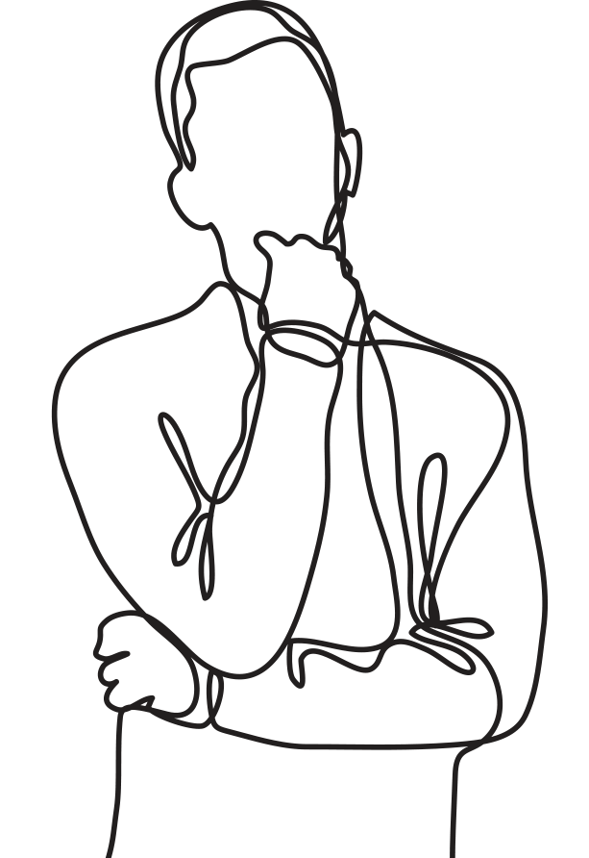
LIVING TRUST
SINGLE INDIVIDUAL
NO LEGAL PARTNER TO HANDLE LEGAL AND MEDICAL AFFAIRS UPON INCAPACITY OR DEATH
NEED A LEGAL DOCUMENT TO DESIGNATE WHO CAN MAKE LEGAL AND MEDICAL DECISIONS
Notes:
COURTNEY
Single individuals have special estate planning needs

Slide 29
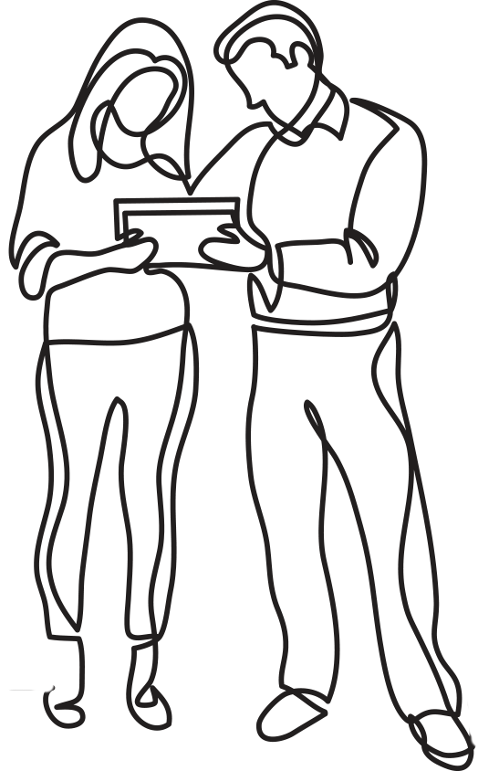
LIVING TRUST
MARRIED COUPLE
TWO SEPARATE TRUSTS
Estate is $4 million
Different beneficiaries for each spouse
JOINT TRUST
Provides for both spouses while either is living
Same set of beneficiaries for both spouses
Notes:
COURTNEY

Slide 30
LIVING TRUST
Trusts are ineffective until funded
Your trust does not have a list of your assets
Assets that aren’t retitled will go through probate because they’re still in your name
FUNDING IS CRUCIAL
Funding: Retitling your assets to the name of the trust
Notes:
COURTNEY

Slide 31
A PROPERLY DRAFTED LIVING TRUST ALLOWS YOU TO . . .
PLAN FOR YOURSELF, CHILDREN, AND FUTURE GRANDCHILDREN
CONTROL PROPERTY DURING YOUR LIFE
PROVIDE FOR YOUR
DISABILITY
GIVE WHAT YOU HAVE, TO WHO YOU WANT, THE WAY YOU WANT, WHEN YOU WANT
SAVE TAX DOLLARS, COURT COSTS, AND ATTORNEY FEES
Notes:
COURTNEY
ANIMATION: CLICK FOR NEXT ONE
“Just to reiterate what a living trust can do for you should you decide to build your estate plan using this tool…..”

Slide 32
TRANSFER ON DEATH DEED
*Transfer property directly to
beneficiaries without probate
Simple to create, fund and administer
Economic alternative if Living Trust isn’t needed to avoid probate
Simple alternative if beneficiaries have good relationships and don’t need asset protection or controls
Problematic if unforeseen circumstances arise
Notes:
COURTNEY

Slide 33
____________________
PLAN FOR INCAPACITATION
Notes:
COURTNEY

Slide 34
Notes:
COURTNEY

Slide 35
Power of Attorney can only be used while the Principal is living and is ineffective at death
AGENT’S AUTHORITY
POWER OF ATTORNEY
The Agent under the POA may not have any authority to make decisions after death
Notes:
COURTNEY

Slide 36
Power of Attorney for Health Care is separate document from Power of Attorney for Property
HEALTH CARE VERSUS PROPERTY
Power of Attorney for Property can only be used for financial matters/assets
POWER OF ATTORNEY
Know the differences.
Power of Attorney for Health Care can only be used for medical purposes
Same terms are used for Health Care POA (Agent and Principal), but often the Agent under Health Care POA is a different individual
Notes:
COURTNEY

Slide 37
____________________
YOUR COMPLETE ESTATE PLANNING
PORTFOLIO
Notes:
COURTNEY

Slide 38
Power of Attorney for Property
Power of Attorney for Health Care
COMPREHENSIVE ESTATE PLAN
Living Will
Tangible Property Distributions
Deeds to real estate handled properly
Pour Over Will (if Living Trust plan)
Notes:
COURTNEY

Slide 39
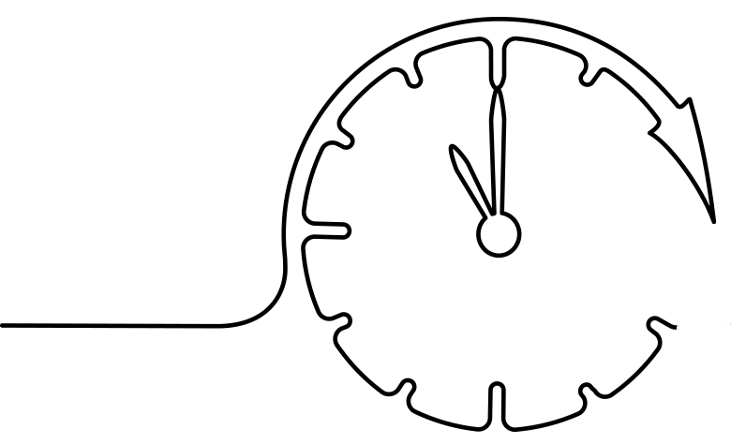
ESTATE PLANNING 101
What’s preventing you from creating an estate plan?
MONEY
TIME
Notes:
COURTNEY
CLICK FOR ANIMATION
Money Objection: Some people may have a hard time with the initial fees for setting up a professional estate plan. So, they either never create one, or they go online and pay $50 for a generic template. Unfortunately, when their family discovers what they set up isn’t going to work, it’s too late – you do get what you pay for.
Solution: When you set up an estate plan, you’re setting up an investment. You will get a return on it – tangibly in protecting and distributing your assets how you choose, and intangibly in that you and your loved ones are taken care of. There may be a higher cost up front, but it pales in comparison to the exponential time, money and grief that will be expended at the back end.
CLICK FOR ANIMATION
Time Objection: We’re so grateful you took the time to watch this webinar, but we’re well aware that your time can quickly fill up with things. Estate planning could easily become a back-burner item on your to-do list. However, once something happens and you didn’t prepare for it, it’s too late. Your family will be in survival mode trying to urgently put the pieces together. You can prevent this from happening.
Solution: We make meeting with us easier. It’s free to get started – we offer complimentary consultations. We meet where you’re comfortable – phone, zoom, in-office. If you have questions, we have answers - depending on your situation. We will make sure you and your assets are well-protected with an estate plan that best fits your situation.

Slide 40
Phone: 630.665.2300
Website: www.trust-lawgroup.com
Email: jennifer@trust-lawgroup.com
courtney@trust-lawgroup.com

