Slide 1
APRIL 2022
BROKER SLIDES

Slide 2
ADVOCACY
HB 2775 (Rep. LaShawn Ford - 8th, Chicago/Sen. Ram Villivalam, D-8th, Chicago) – The Senate Executive Committee held a hearing to discuss the amendment Illinois REALTORS fought hard to get on HB 2775. The amendment pares down significantly the original bill, which had many onerous provisions in addition to the traditional “Source of Income” language. While Illinois REALTORS® remains philosophically opposed to this initiative, we supported the amendment which greatly reduced our concerns. The amended bill passed the Senate with a 30-17-0 vote.
The amended bill removed a lot of additional requirements like Just Cause Evictions and will now simply codify the source of income that is similar to the current requirements in Naperville and Cook County.
https://www.illinoisrealtors.org/advocacy/

Slide 3
ADVOCACY
HB 4322 (Rep. Curtis Tarver, D-25th, Chicago/Sen. Elgie Sims, D-17th, Chicago) – Makes clarifications in the Residential Real Property Disclosure Act. Illinois REALTORS® worked on this legislation with the Illinois Real Estate Lawyers Association, and we SUPPORT this legislation, as amended. The bill passed in the Senate on Thursday with a 53-0-0 vote and will now be sent to the Governor.
The changes are minimal – Same number of questions. A question was removed and an existing question in relation to flood insurance was broken into two questions. Once it is signed by the Governor and a new Residential Real Property Disclosure Form is available, Mainstreet will notify you of the release.
https://www.illinoisrealtors.org/advocacy/

Slide 4
BROKER RENEWAL 4.30.22
Challenges during IDFPR License renewal:
Forgot my password
Registration process
Licensees when reaching out to call center can’t receive assistance with login credentials
Best Solution:
Email IDFPR at fpr.realestate@Illinois.gov
IDFPR will respond to emails within 24 hours
Missed the webinar with IDFPR on Virtual Offices?
Recording: https://www.facebook.com/SucceedWithMORe/videos/566834221697944

Slide 5
SENTRILOCK
Are you looking for a secure option to provide One-Day Codes?
SentriConnect app is that tool!
Allows the listing agent, listing office, or one with lockbox owner privileges on an assigned property to issue one-day codes through this non-SentriLock REALTORS® app.
The app can be used for non-SentriLock REALTORS® and Non-REALTOR® users (cleaning, inspectors etc.) to access the one-day code and the listings.
How to Use SentriKey Real Estate App to Grant Access to SentriConnect
https://youtu.be/TG0TQOIIBDk
How to set-up SentriConnect
https://youtu.be/o8-oR5x_-YQ

Slide 6
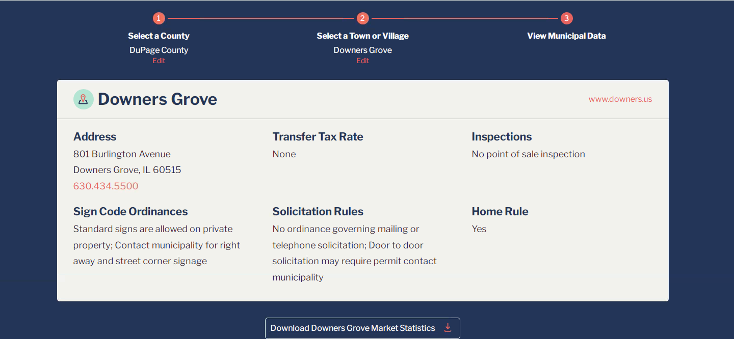
MEMBER BENEFIT: MORE MUNICIPAL DATA
https://www.succeedwithmore.com/Career-Resources/market-stats/MORe-Municipal-Data/
Notes:
Unlimited usage and tech help is for hardware and software issues.

Slide 7
UPCOMING COURSES AND EVENTS
Affordable Options for Seniors 5.2.2022
Put the PRO Back into Professionalism (YPN) Series 5.4.2022
Law Day ~ A MUST ATTEND EVENT~ 5.9.2022
Brokerage Forum 5.17.2022
Coffee & Conversation: TikTok 5.19.2022
News & Brews: Position Yourself as a Community Expert 5.24.2022
CRB: Starting a Real Estate Company 5.24.2022
20 Under 40 Winners Announced 5.25.2022
Selling a Business: Hosted by Commercial Alliance 5.26.2022
SucceedWithMORe.com/calendar

