Slide 1
August 2022
BROKER SLIDES

Slide 2
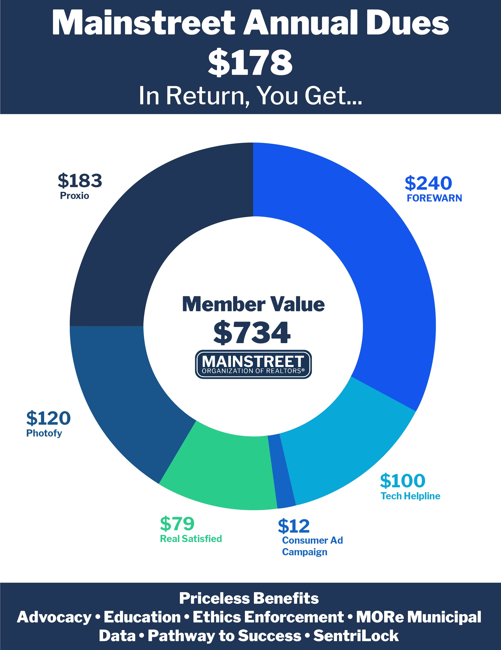
VALUE OF MAINSTREET
Annual dues billed in July
Due December 1st
Pay when it’s convenient for you
Why invest in RPAC? 2022 WINS
Source of Income Protections (HB 2775): REALTORS® beat back a far-reaching proposal that forced housing providers to accept any government or non-profit subsidy, limited rental amounts and neutered the eviction process. REALTORS® proactively worked with leaders in the Illinois Senate to pass a Bill that will protect those seeking housing with a housing choice voucher.
Condo HOA Reporting (HB 4158): REALTORS® helped pass a bill that protects consumers by mandating Condo Boards to maintain records of reserve studies.
Electric Vehicle Charging Act (HB 3125): REALTORS® stopped an aggressive mandate that would have driven up housing costs by forcing all new construction to include electric vehicle charging stations.
Vacancy Fraud Act (HB 3477): REALTORS® stopped a Bill that sought to hold property owners criminally liable if they had vacant units.

Slide 3
WE NEED YOUR HELP
Are you a REALTOR® Public Official?
We would love to know in what municipal
capacity you serve your community.
Email Nadine@SucceedwithMORe.com

Slide 4
CODE OF ETHICS
Article 12 and Advertising
REALTORS® shall be honest and truthful in their real estate communications and shall present a true picture in their advertising, marketing, and other representations. REALTORS® shall ensure that their status as real estate professionals is readily apparent in their advertising, marketing, and other representations, and that the recipients of all real estate communications are, or have been, notified that those communications are from a real estate professional.
Boil it Down:
Always present a true picture in your real estate communications and advertising.
Always disclose your status as real estate professional in advertising and other representations.
Violations of Article 12, begin with an automatic $250.00 fine.

Slide 5
SENTRILOCK
Are you looking for a secure option to provide One-Day Codes?
SentriConnect app is that tool!
Allows the listing agent, listing office, or one with lockbox owner privileges on an assigned property to issue one-day codes through this non-SentriLock REALTORS® app.
The app can be used for non-SentriLock REALTORS® and Non-REALTOR® users (cleaning, inspectors etc.) to access the one-day code and the listings.
How to Use SentriKey Real Estate App to Grant Access to SentriConnect
https://youtu.be/TG0TQOIIBDk
How to set-up SentriConnect
https://youtu.be/o8-oR5x_-YQ

Slide 6
MEMBER BENEFIT: INMAN SELECT
In partnership with:
Complimentary Inman Select real estate news subscription!
(Log-in Required)
https://www.illinoisrealtors.org/membership/memberbenefits/inman/

Slide 7
UPCOMING COURSES AND EVENTS
Sept. REALTOR® Safety Month
9.2.22 Top 10 RE Investing Mistakes
9.6.22 Financial Analysis for Commercial
9.15.22 Installation Celebration
9.16.22 Real Estate Safety
9.22.22 Coffee & Conversation: Reinventing Space
9.23.22 Cybercrime & Human Behavior
9.27.22 Book Club: Ageism
9.29.22 SFR: Short Sales & Foreclosure Certification
SucceedWithMORe.com/calendar

