Slide 1
AUGUST 2023
BROKER SLIDES

Slide 2

UPDATED SELLER DISCLOSURE FORM
The Illinois Residential Real Property Disclosure Act has been updated. The changes became effective Aug. 4, 2023 upon Governor Pritzker’s signature.
The Disclosure Report required for most sellers in residential transactions does not change. However, the definition of seller has been tweaked somewhat to reduce the class of sellers who would need to complete the form.
Here is the key explanation:
The definition of the seller under the Act does NOT include a beneficiary who BOTH never occupied the residential real property AND never had management responsibility for it.
In other words, if a seller is a beneficiary and does occupy the property OR has management responsibility for it (i.e. is an absentee owners), this beneficiary IS a seller under the Act and must complete the report to the best of their actual knowledge.
The new revision date of the form is Aug. 4, 2023. Please be sure to update your forms on connectMLS by going to the Illinois REALTORS library and adding the form to your folders.

Slide 3



CONGRATULATIONS
2023 PATHWAY
TO SUCCESS WINNERS

Slide 4
SEPTEMBER IS REALTOR®
SAFETY MONTH
Since 2003, the National Association of REALTORS® has dedicated September as REALTOR® Safety Month.
Whether you’re showing a property, meeting a new client or communicating online, it’s important to ensure you have an existing personal safety protocol.
Mainstreet and NAR offers an array of safety resources, including tips and articles, safety training videos, courses and presentation materials, and safety-focused webinars. All are part of the ongoing efforts to communicate and educate REALTORS® about safety throughout the year.
Mainstreet Safety Resources - https://www.SucceedWithMORe.com/safety
NAR Safety Resources - https://www.nar.realtor/safety

Slide 5
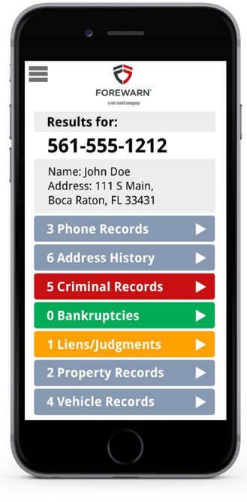
MEMBER BENEFIT:
FOREWARN – NEW ENHANCEMENTS
FOREWARN enhancements that prioritize safety while enabling members to best serve their prospects and customers. New features include:
Deceased Indicator – Users can reference the deceased indicator to help assess whether a prospect may be misappropriating the identity of a deceased person.
Emailed Prospect Report – With one click users can now instantly email themselves a prospect report PDF to reference later.
Foreclosures, Liens, and Judgments – Users now have a broader history of customer details to help better understand and address their prospect's needs.

Slide 6
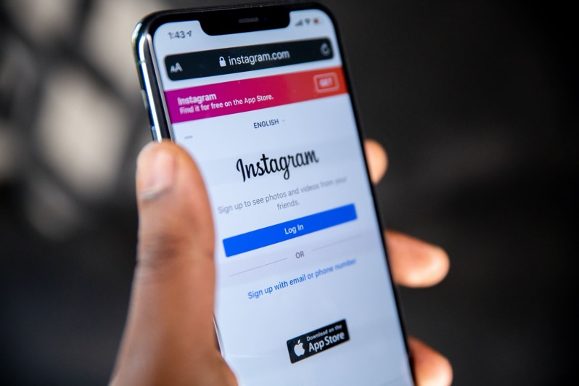
MEMBER BENEFIT:
REAL SATISFIED– NEW ENHANCEMENTS
Showcase your newest testimonials on Instagram and LinkedIn hassle-free. All you need to do is activate your Instagram and LinkedIn connections in the Publishing section of your Agent Dashboard, and voilà! You’re ready to go.
Enable LinkedIn and Instagram publishing

Slide 7
UPCOMING
COURSES AND EVENTS
9.1.23 Real Estate Negotiation Expert (RENE)
9.12.23 Tim Ryan and Board of Directors Installation
9.14.23 Coffee & Conversation: How to Talk to Sellers
9.14.23 Safety & Self Defense for REALTORS®
9.14.23 Commercial Boot Camp
9.23.23 Digital Domination: New Member Boost Session
9.27.23 Safety & Self Defense for REALTORS®
9.18 – 9.21 Illinois REALTORS® Fall Business Meetings Register HERE
SucceedWithMORe.com/calendar

