Slide 1
DECEMBER 2022
BROKER SLIDES

Slide 2
NEW SOURCE OF INCOME LAW
On May 23, 2022, Governor JB Pritzker signed HB 2775 into law. Effective January 1, 2023, housing providers may continue to use business criteria to screen tenants, but will no longer be able to turn renters away from available housing simply because of their source of income.
The legislation amends the Illinois Human Rights Act to add source of income as a protected class and provides people seeking housing with nonwage incomes the same legal protections against discrimination that are available based on race, disability, familial status, sexual orientation, and other factors.
Mainstreet hosted 4 Source of Income law events in November at each of our locations. Missed it? Catch a recording here (login required):
SucceedwithMORe.com/Career-Resources/more-on-demand/fair-housing/

Slide 3
THE REALTOR® DIFFERENCE
Helping you communicate your value as a REALTOR® Leverage National Association of REALTORS® branding language and creative assets to distinguish yourself from non-member agents.
As a REALTOR®, you know the value you bring to your clients and communities every day. The difference is real when working with a REALTOR® versus a non-member agent, and it’s important for consumers to understand that distinction.
Access The REALTOR® Difference: www.thedifference.realtor
Watch this Coffee & Conversation Value Proposition video to learn how to leverage the member value proposition language and assets with Lynn Madison (login required):
SucceedwithMORe.com/Career-Resources/more-on-demand/hot-topics/

Slide 4
NAR’s 30 under 30
Each June, REALTOR® Magazine features 30 rising young stars in the real estate industry, and hundreds of real estate practitioners apply to be one of the honorees.
Do you have an agent who should apply?
Applications open till January 18, 2023
https://www.nar.realtor/magazine/30-under-30/30-under-30-faq-and-contest-rules

Slide 5
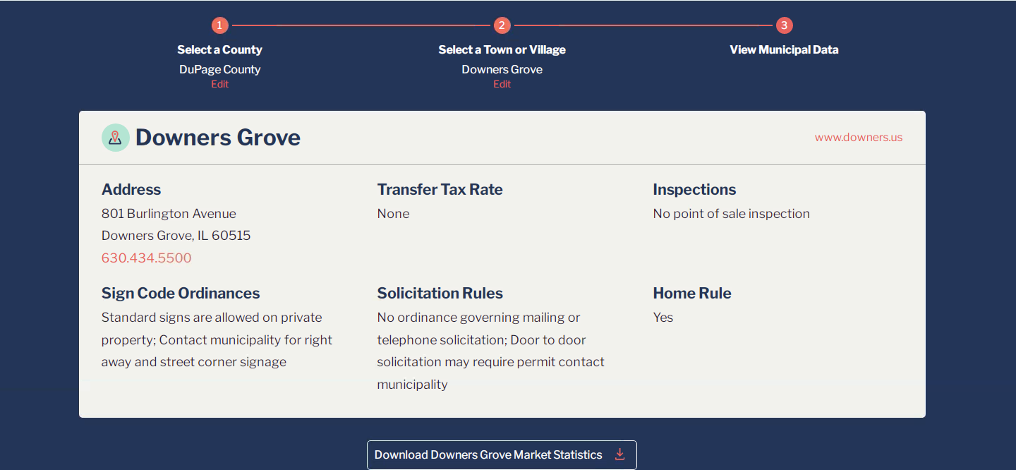
MEMBER BENEFIT: MORe MUNICIPAL DATA
Succeedwithmore.com/Career-Resources/market-stats/MORe-Municipal-Data/

Slide 6
UPCOMING COURSES AND EVENTS
1.4.23 RENE: Real Estate Negotiation Expert
1.6.23 45 Hour Broker Post Licensing
1.9.23 Applied Brokerage Principles
1.12.23 12 Hour Broker Management
1.13.23 Commercial Economic Outlook
1.17.23 12 Hour Broker Management
1.18.23 Color Workshop for REALTORS
1.19.23 Coffee & Conversation: C2EX
1.27.23 CSC: Certified Staging Consultant
SucceedWithMORe.com/calendar

