Slide 1
April
Broker Slides

Slide 2
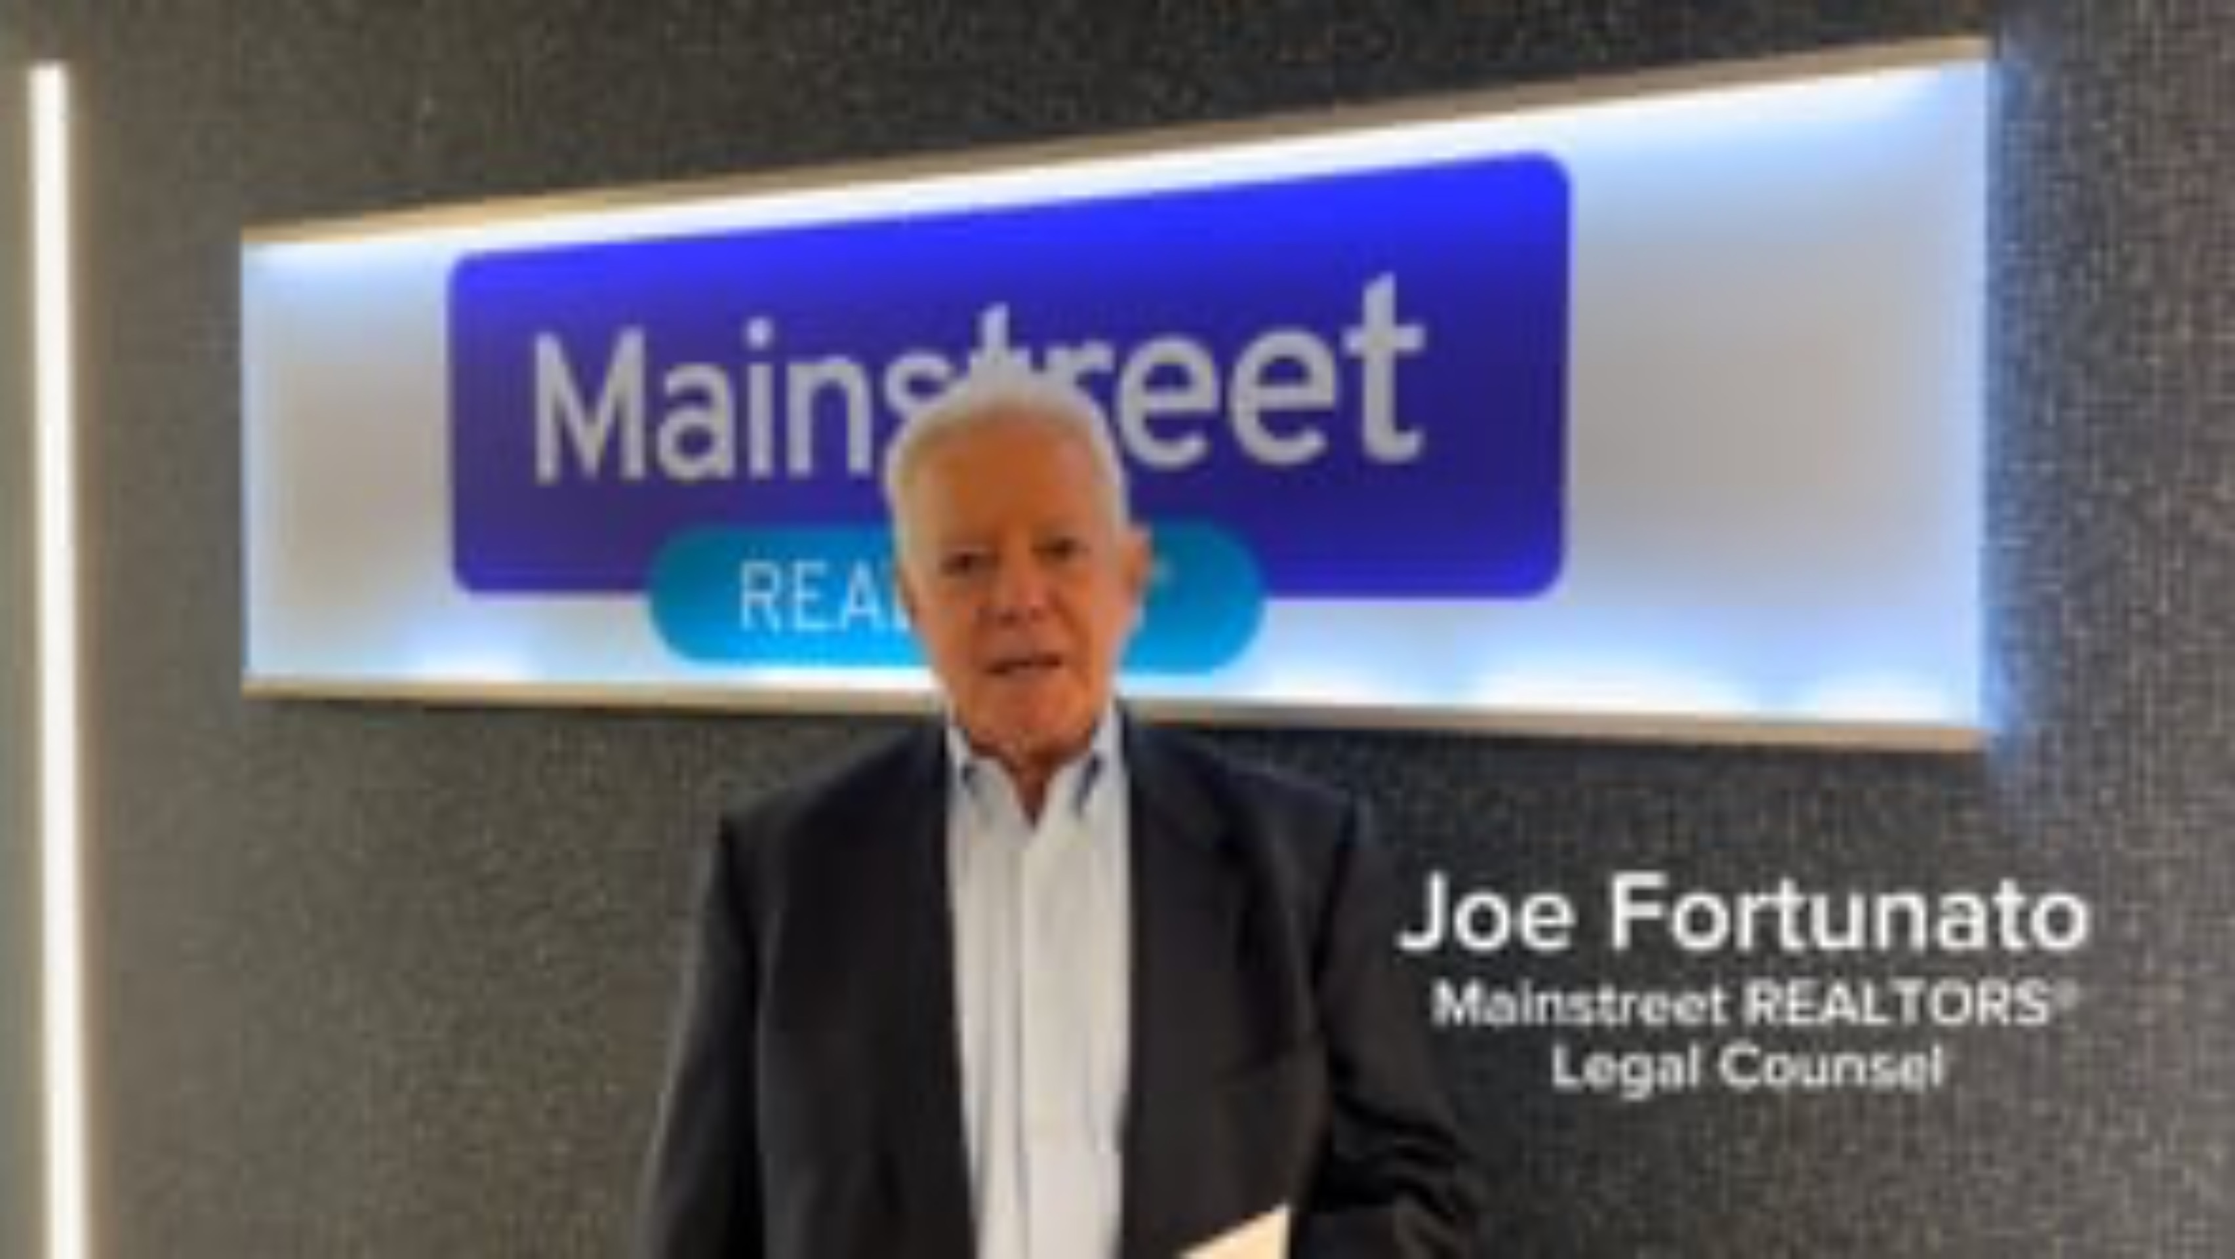
Important Notice:
The Multi-Board Residential Real Estate Contract 8.0 (and preceding versions) are protected under U.S copyright law. The form language within the document may not be modified, reproduced or distributed without the express written permission of the copyright holders.
It has come to Mainstreet’s attention that a version of the Multi-Board Residential Real Estate Contract 8.0 has been altered and used in a real estate transaction. Altering the content of any copyrighted form is a violation of federal law. Unauthorized modifications not only expose both the member and their clients to legal risks but undermines the legal integrity of the document. REALTORS® often experience unique situations during real estate transactions. If you believe that form language should be modified, please reach out to Mainstreet’s Professional and Ethical Practices Department so that they may ensure that your concerns are recorded and appropriately addressed. We appreciate your cooperation in upholding the integrity and legal protections of our professional forms and contracts.

Slide 3
Win $250 – Complete our Contracts & Forms Survey
We want your feedback to better align our Contracts & Forms Library with your needs as a real estate professional. Complete the survey below and tell us what works for you (and what doesn’t) to help us become a better resource for YOU.
To say thank you for your time, complete the survey and enter your contact information for an opportunity to win one of three $250 gift cards.
TAKE SURVEY

Slide 4
Updated Mainstreet Forms & Contracts
  Mainstreet is committed to making things easy. As part of our commitment to helping you navigate the continued changes in our industry, these updated forms are designed to keep you in compliance as well as ensure that changes made to the Multi-Board Residential Real Estate Contract 8.0 are reflected in the forms you use most. The changes to the listing agreements also reflect changes to the compensation paragraphs to meet the ongoing needs of the marketplace.
  VIEW FORMS

Slide 5

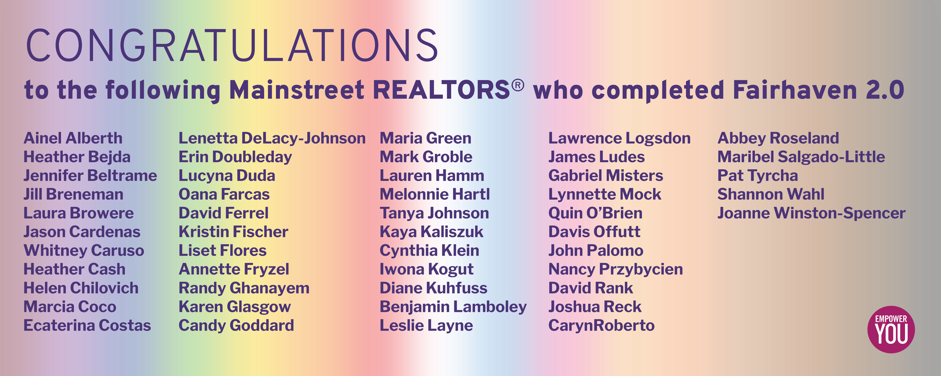
Click here to complete today!

Slide 6


Slide 7


Slide 8


Slide 9

Mainstreet Calendar – May
Law Day
45 Hour Post Licensing
Brokerage Forum
Unlocking Real Estate Opportunities in Mexico
SRES Advantage Summit
Mainstreet Volunteer Day – Feed My Starving Children
Coffee & Conversation: Law Day Debrief
Commercial Mini Summit

