Slide 1
July
2024
Monthly Broker Slides

Slide 2
August 2024 Practice Changes
August 5-
Forms and Contracts Released
Video Tutorials Released
Summary of Changes Released
FAQ’s Released
August 17 –
New NAR MLS policy takes effect to implement practice changes
No unilateral offer of compensation in the MLS
Buyer agreements required prior to showing a home (in-person or virtual)
Email: Lynnette@succeedwithmore.com to schedule an office presentation

Slide 3
Contracts & Forms
Town Hall Webinars Coming Soon!
August 2024 Practice Changes
Transition Addendums for Mainstreet Agreements
Listing Agreement (Right to Sell and Agency)
Buyer Agreement (Exclusive and Non-Exclusive)
Exclusive Right to Sell Marketing Agreement
Exclusive Agency Marketing Agreement
Listing Modification Form
Exclusive Buyer Representation Agreement
Non-Exclusive Buyer Representation Agreement
Buyer Modification Form
7.0 Compensation Addendum
NEW “Generic” Compensation Addendum
NEW “Notice of Compensation
NEW “Notice of No Agency”
Brokerage to Broker Compensation Agreement
Brokerage to Brokerage Referral Agreement
Contracts and forms to assist with practice changes

Slide 4
Resources
NAR Resource for Members
NAR Resource for Consumers
Mainstreet Resource
MRED Resource
Coffee & Conversation – What you need to know
Mainstreet is offering in-office the ABR Course at no cost! Contact Marys@succeedwithmore.com
To schedule today!

Slide 5
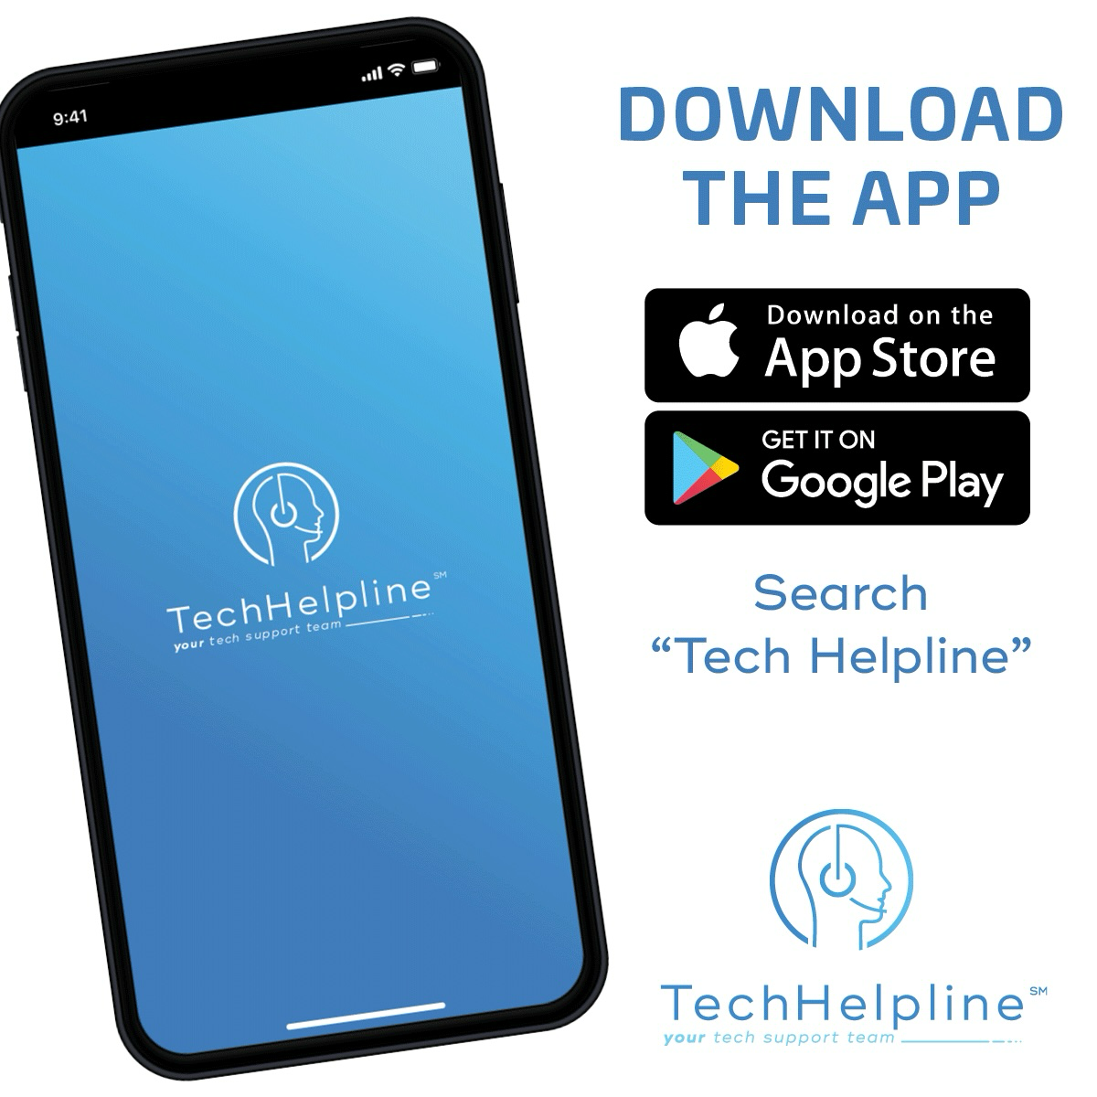
Tech Helpline
There's no need to sign up for anything, your account is attached to your active Mainstreet REALTORS® membership and is ready to be used when you need it. When you need assistance, the process is simple:
Contact Tech Helpline via the app.
They’ll verify your active Mainstreet REALTOR® membership.
They’ll troubleshoot the problem or provide answers to your questions.

Slide 6
Upcoming Courses & Events
August 13 Naperville
August
Mapping out your 2024 Market Strategy – Boost Session
Propel: Igniting Innovation in Technology
Jumpstart your Business with RPR®
Brokerage Forum
Week of August 5 and 13 - Forms and Contracts Town Hall’s – Dates and times to be released soon!
August 22 - Coffee & Conversation: How to use the MLS to Generate Leads

