Slide 1
May
Broker Slides

Slide 2

One Week Left! Make Your Voice Heard –
Join a Mainstreet Committee
Shape the Future of Real Estate with Us
Mainstreet Committees are where ideas become action. Whether you’re passionate about advocacy, education, events or member engagement, there’s a place for you. But time is running out – applications close on May 31!
Build your leadership skills
Expand your network
Make a meaningful impact on your industry
Apply now – Deadline is May 31
www.succeedwithmore.com/committees

Slide 3
National Market Pulse
Mortgage Rates Edge Above 7% Following U.S. Credit Downgrade
Moody’s recent downgrade of the U.S. credit rating from AAA to Aa1 has pushed 30-year fixed mortgage rates above 7%. This uptick is adding pressure to an already strained housing affordability landscape, with home sales at a 30-year low. However, builders are responding by offering more price cuts. 34% of them reduced prices in May, up from 29% in April. MarketWatch
Rising Rents Continue to Drive Inflation
In April 2025, shelter costs accounted for over half of the 0.02% increase in the Consumer Price Index. Over the past five years, average apartment rents have risen 29%, and single family home rents have surged 43%, outpacing median household income growth. While some data suggests recent stabilization, economic uncertainty and high construction costs may lead to renewed rent increases. MarketWatch

Slide 4
Chicagoland Market Pulse
  Inventory is Growing
  Listings hit a new YTD high
  5,967 homes listed the week of May 19
  Outpacing same week in 2024
  Closings up to 2,168 (vs 1,992 prior week)
  Prices Continue Climbing
  Year-over-year growth
  Single-family: +7.5%
  Condos & townhomes: +7.5%
  Buyer Activity Dips
  Contracts are slowing slightly
  Homes under contract dropped to 3,161
  Down from 3,561 the previous week
  Looking Ahead
  2025 is trending positive
  National home sales projected to rise 9-13%
  Chicago/Chicagoland expected to benefit from more inventory and stable job growth

Slide 5
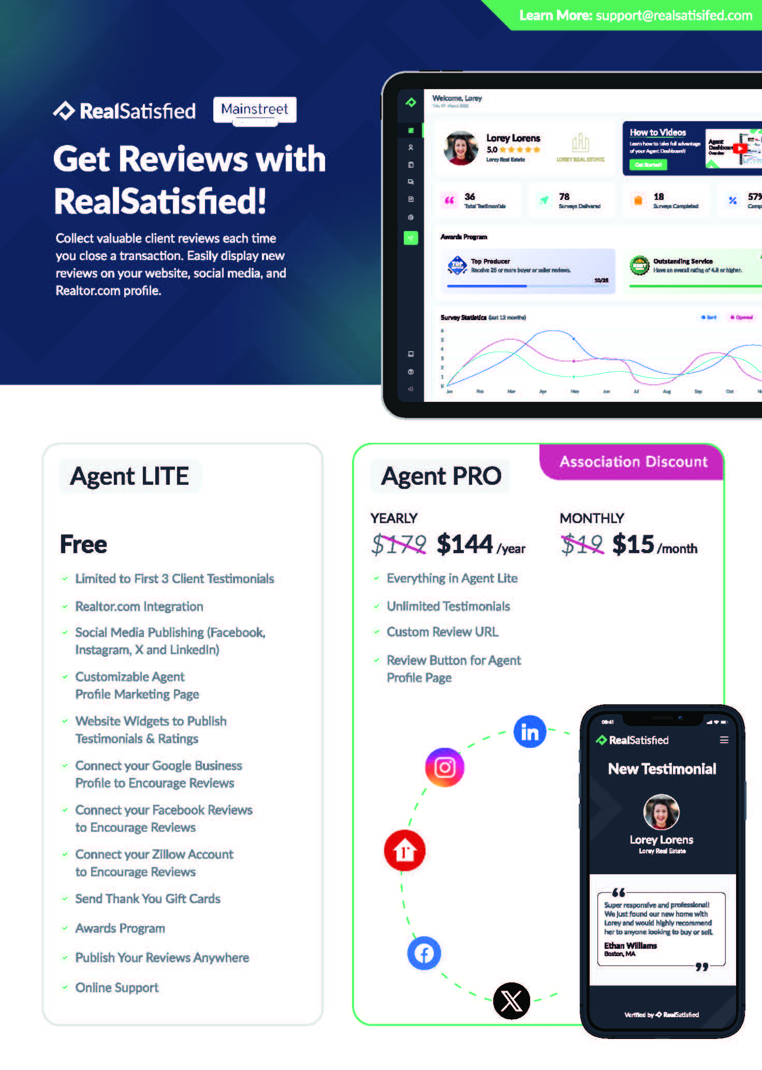
Benefit Spotlight
You already do the work. Now get the credit.
Mainstreet members have access to RealSatisfied Lite at no cost. It’s an easy way to automatically collect client testimonials after every closing.
Build your online reputation
Gather honest client feedback
Share your success on social media & Google
Looking for more tools? You can upgrade to Pro at a discounted member rate.

Slide 6
Mainstreet Calendar – June
Commercial Boot Camp
MRED Training – Realtor Property Resource (RPR)
Taco Tuesday Unconference & Mainstreet 20 under 40 Reception
Working with Residential Landlords & Tenants
Understanding Housing Choice Vouchers
Content that Converts: A Short Form Video Workshop for REALTORS
Coffee & Conversation: Inside the Luxury Market
Senior Real Estate Specialist (SRES) Designation

