Slide 1
September
2024
Monthly Broker Slides

Slide 2
Mainstreet Offers You a Better Way to Resolve a Dispute
Professional Hotline: Call 630.324.8400 and select the Professional and Ethical Hotline
When you have ethical, transactional or professional standards questions, you need quick answers. The Mainstreet Professionalism Hotline is staffed by trained experts who are standing by to help members and consumers with questions related to real estate transactions.
Ombudsman: Call 855.737.6990
Sometimes disputes just need facilitated conversation to get both parties on the same page. Our Ombudsman program offers an option for resolution that can help facilitate and bridge conversations between parties in conflict. This peer-driven process is confidential and allows you to bypass a lengthy complaint process.
Our Ombudsman Team is comprised of members and REALTORS® who have gone through mediation training and are well-versed on the Code of Ethics and the Professional Standards process.

Slide 3
Resources
NAR Resource for Members
NAR Resource for Consumers
Mainstreet Resource
MRED Resource
Practice Change Resources
Mainstreet is offering the ABR Course in-office at no cost! Contact Marys@succeedwithmore.com
To schedule today!

Slide 4

Congratulations Mainstreet REALTORS®

Slide 5
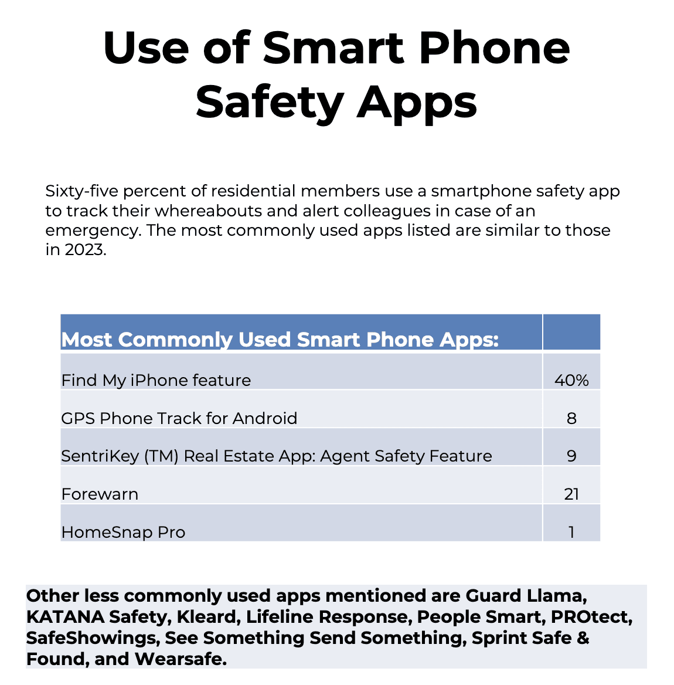
REALTOR Safety Month
2024 NAR Member Safety Residential Report
Key Findings:
Over the Past 12 Months, 60% of residential members said that they had not met a new or prospective client alone at a secluded location or property.
73% of residential members said that they have personal safety protocols in place that they follow with every client. This is more likely among females (77%) than among males (63%).
41% of residential members said that they have participated in a self-defense class.
47% of men and 54% of women carry a self-defense weapon or tool.
Succeedwithmore.com/safety

Slide 6
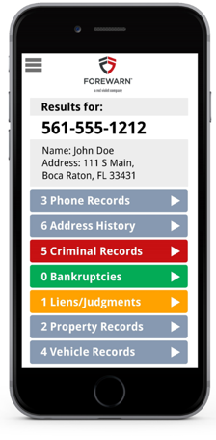
FOREWARN
FOREWARN prioritizes safety while enabling members to best serve their prospects and customers. Features include:
Deceased Indicator – Users can reference the deceased indicator to help assess whether a prospect may be misappropriating the identity of a deceased person.
Emailed Prospect Report – With one click users can now instantly email themselves a prospect report PDF to reference later.
Foreclosures, Liens, and Judgments – Users now have a broader history of customer details to help better understand and address their prospect's needs.
Succeedwithmore.com/forewarn

Slide 7

Upcoming Courses & Events
October
Buyer Agency Agreements Explained
Financing Residential Transactions
Oktoberfest
Tax Reduction Strategies
Inter-Chamber Speed Networking with YPN
45 Hour Post Licensing
Coffee & Conversation: Understanding Your Healthcare Options
CCIM Market Analysis for Commercial Investment Property

