Slide 1
FEBRUARY 2022
BROKER SLIDES

Slide 2
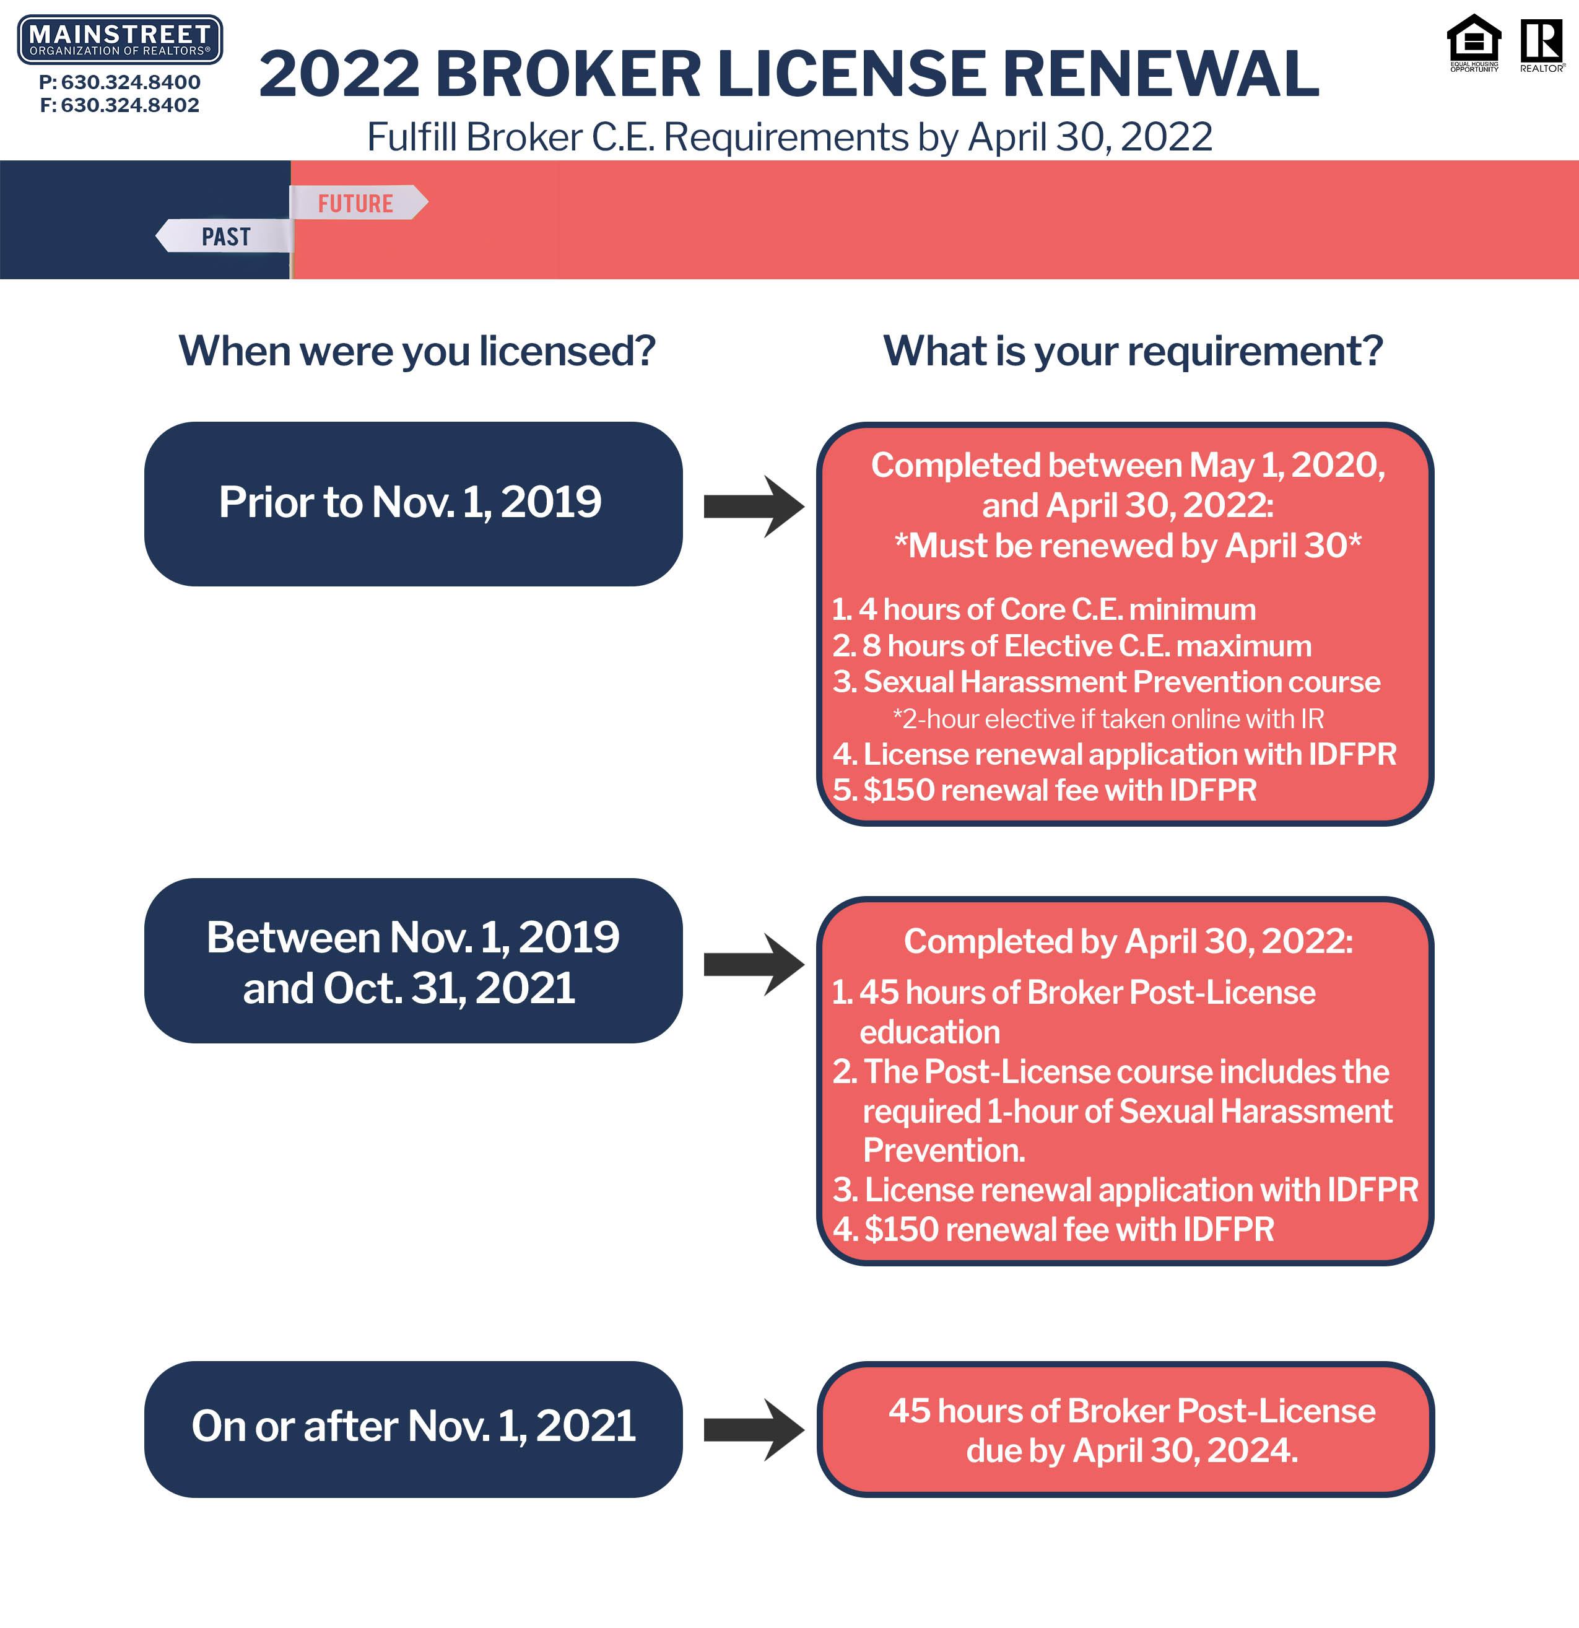
BROKER RENEWAL

Slide 3
REALTOR® Political Action Committee (RPAC)
Option 1: RPAC Major Investor - $1000 Investment (split into 11 monthly payments)
Option 2: Minimum Investment - $20
So grab your nrds number and head over to
RPACNow.com to make your investment.
Questions? Contact Kim@SucceedwithMORe.com

Slide 4
MEMBER BENEFIT: PHOTOFY
Notes:
Unlimited usage and tech help is for hardware and software issues.

Slide 5
UPCOMING COURSES AND EVENTS
ABR: Accredited Buyers Representative 3.1.2022
45 Hour Post Licensing – Virtual 3.5.2022
Own Who You R®: Celebrating Women in RE 3.8.2022
45 Hour Post Licensing – Live & Virtual 3.8.2022
Illinois 4-Hour Core 3.8.2022
Conflict Resolution - Virtual 3.16.2022
Coffee & Conversation with IDFPR 3.24.2022
www.SucceedWithMORe.com/calendar

