Slide 1
FEBRUARY 2023
BROKER SLIDES

Slide 2

2023 COOK COUNTY LEASE
The Cook County Lease for 2023 is now available
(log-in required)!
SucceedwithMORe.com/globalassets/member-locked-files/contracts-and-forms/residential-property/cook-county-lease.pdf

Slide 3
CODE OF ETHICS (CITATION) UPDATE
Standard of Practice 1-8 was added to the citation policy at NAR and Mainstreet with a $250 fine:
Failure on the part of a buyer’s/tenant’s broker to provide, as soon as practical, a written affirmation to the listing broker stating that the counter-offer has been submitted to the buyers/tenants, or a written notification that the buyers/tenants have waived the obligation to have the counter-offer presented.

Slide 4

CAPITOL CONFERENCE

Slide 5

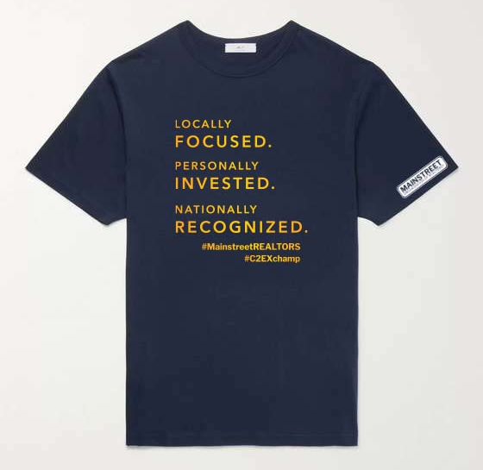
COMMITMENT TO EXCELLENCE (C2EX)
Completed your C2EX endorsement? If so, pick up your free shirt in Downers Grove or email Lynette Mock at Lynnette@succeedwithmore.com to schedule pick up in Tinley Park, Rolling Meadows, or Libertyville offices.
C2EX.REALTOR

Slide 6
UPCOMING
COURSES AND EVENTS
3.1.23 Be the Star: Creating Referrals That Stick (Hosted by YPN)
3.6.23 Power of the PAC Trivia Night
3.7.23 12 Hour Broker Management
3.7.23 CSC: Certified Staging Consultant
3.8.23 Own Who You R: Celebrating Women in Real Estate
3.13.23 12 Hour Broker Management
3.13.23 Straighten Up! Strategies for Decluttering and Downsizing
3.13.23 Commercial Boot Camp
3.16.23 South Cook Confidential – Municipal Officials
3.17.23 Accessorizing Workshop for REALTORS®
3.20.23 SRS: Seller Representative Specialist
3.22.23 12 Hour Broker Management
3.23.23 Coffee & Conversation: Member Benefits
3.23.23 Team Strategies for Performance
3.28.23 Solar for Real Estate Agents
3.28.23 Become a 1031 Exchange Expert to Grow Your Business
SucceedWithMORe.com/calendar

