Slide 1
JANUARY 2022
BROKER SLIDES

Slide 2
NAR CODE OF ETHICS UPDATE
COE 12.1: REALTORS® must not represent that their brokerage services to a client or customer are free or available at no cost to their clients, unless the REALTOR® will receive no financial compensation from any source for those services.
COE 1.8 Amended: REALTORS®, acting as agents or brokers/tenants, shall submit to buyers/tenants all offers and counter-offers until acceptance but have no obligation to continue to show properties to their clients after an offer has been accepted unless otherwise agreed in writing. Upon the written request of the listing broker who submits a counter-offer to the buyer’s/tenant’s broker shall provide, as soon as practical, a written affirmation to the listing broker stating that the counter-offer has been submitted to the buyers/tenants, or a written notification that the buyers/tenants have waived the obligation to have the counter-offer presented. REALTORS®, acting as agents or brokers of buyers/tenants, shall recommend that buyers/tenants obtain the advice of legal counsel if there is a question as to whether a pre-existing contract has been terminated.
Its important to note that MLS rules set forth by NAR is mandated only for Association owned MLS’s. MRED is not Association owned but rather Broker owned. Look for future information directly from MRED in regards to the NAR MLS changes.

Slide 3
PRODUCTION AWARDS
March 1st, 2022 – Announcement of winners
Secondary members are eligible - NEW
Commercial Brokers will need to submit an application www.SucceedWithMORe.com/productionawards
Top 1%, 2%, and 3% Individuals
Top 1%, 2%, and 3% for Small, Mid, and Large Teams – NEW
Individual and Teams data will be pulled directly from MRED
Questions? Email Win@SucceedWithMORe.com

Slide 4
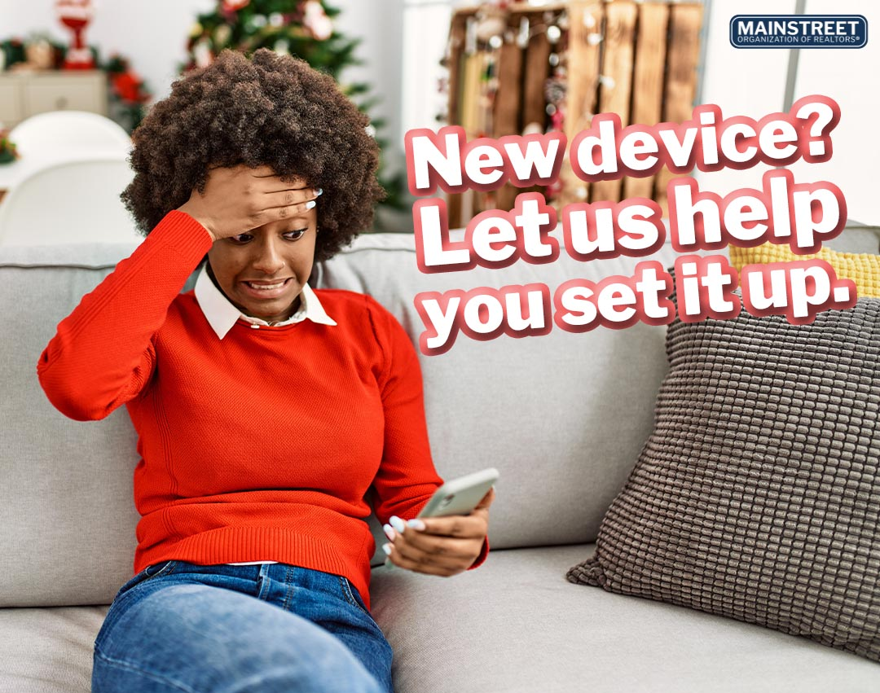
MEMBER BENEFIT: TECH HELPLINE
There's no need to sign up for anything, your account is attached to your active Mainstreet REALTORS® membership and is ready to be used when you need it. When you need assistance the process is simple:
Contact Tech Helpline via phone, live chat or email.
They’ll verify your active Mainstreet REALTORS® membership.
They’ll troubleshoot the problem or provide answers to your questions.
Notes:
Unlimited usage and tech help is for hardware and software issues.

Slide 5
UPCOMING COURSES AND EVENTS
Brokerage Forum 2.7.2022
Certified Staging Consultant 2.15.2022
National Flood Insurance Program 2.15.2022
Leadership Academy 2.17.2022
News and Brews at Light the Lamp Brewery 2.22.2022
Coffee and Conversation: Impact of Redlining 2.24.2022
Short Sales and Foreclosures Certification 2.24.2022
www.SucceedWithMORe.com/calendar

