Slide 1
JULY 2022
BROKER SLIDES

Slide 2
FORM UPDATE
An appraisal gap occurs when an appraised property comes back with a lower value than the accepted offer.
Only to be used with the 7.0 contract
Note from lenders: Buyers will need to pay the appraisal gap plus the required down payment at closing
Notes:
Examples for a & b:
Lists for $270,000 offers $300,000 puts nothing in the optional field appraises at $260,000 buyer would owe $40,000. Lists for $270,000 offers $300,000 puts the list price of $270,000 in the optional field, buyer would only owe $30,000
Adds $20,000 in the blank space but appraisal comes in low and the gap is $30,000 buyer would only be responsible for $20,000 per addendum

Slide 3
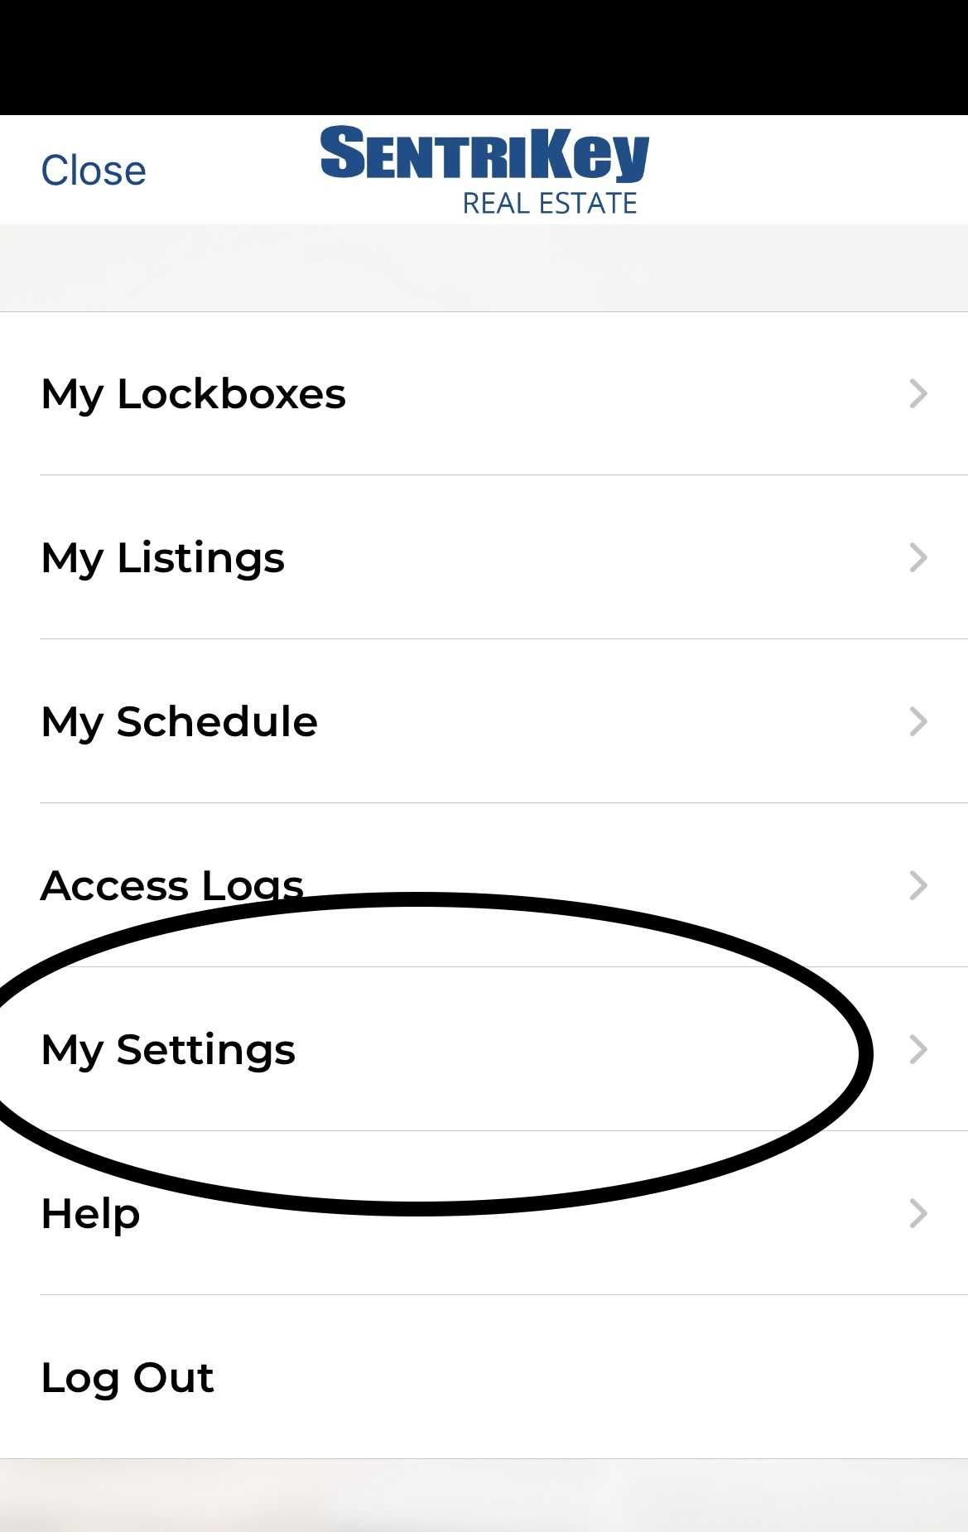
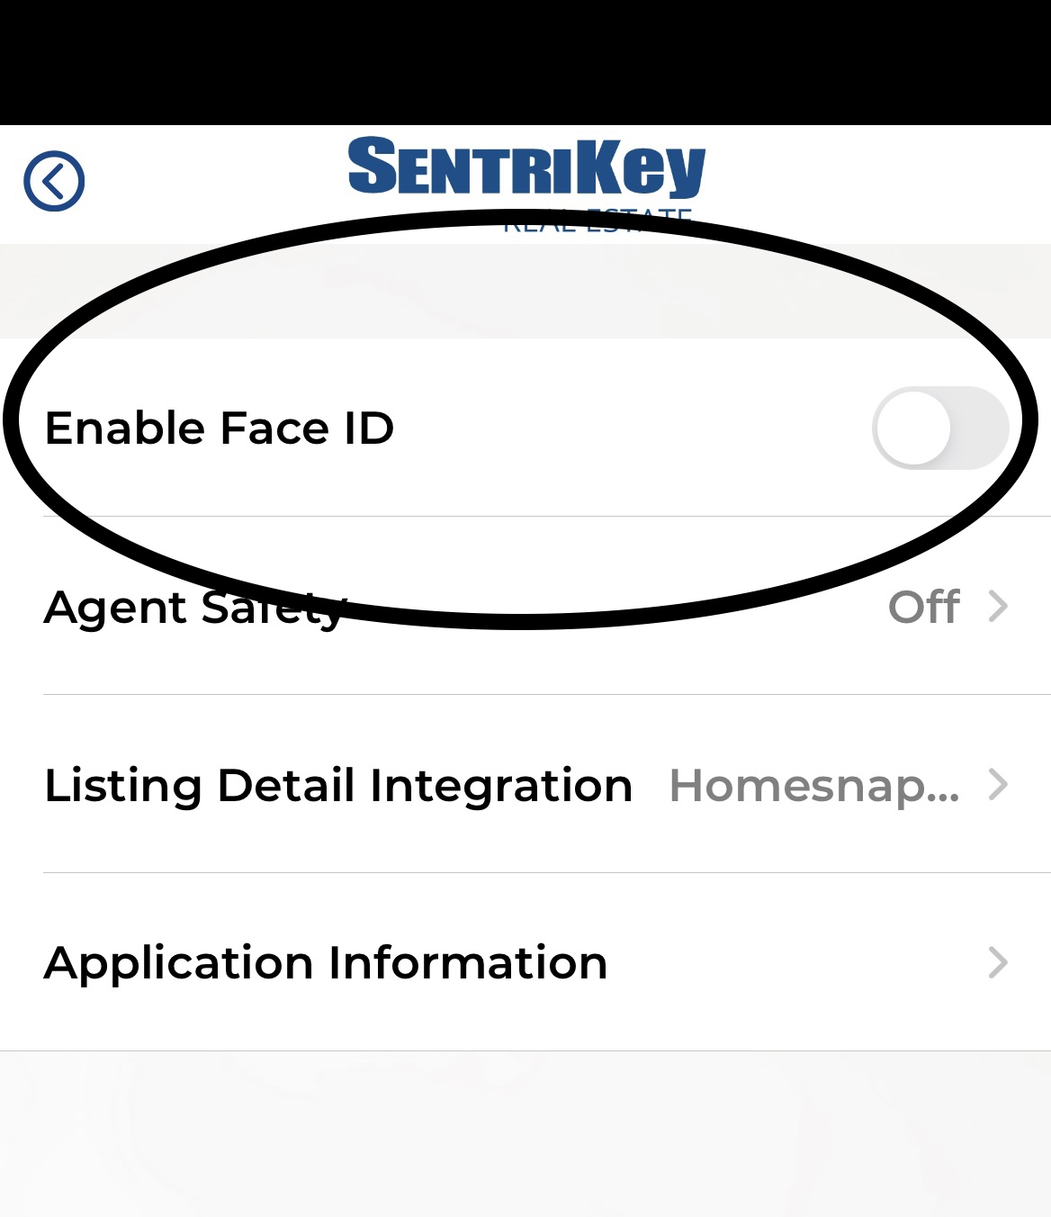
SENTRILOCK
How do I enable Touch ID in the SentriKey Real Estate App?
SentriKey Real Estate app users have the availability to set up Touch ID and Facial Recognition to quickly and easily access your most frequent used functions. You are able to use the recognition feature in place of your PIN and Password to help you be more efficient. Enable Touch ID from your SentriKey settings or through the Opt In Process.
Opt in: When you have downloaded or updated to the latest version of the app you will have the opportunity to enable Touch ID/Facial Recognition to use with SentriKey through the Opt In Screen.
In app:

Slide 4
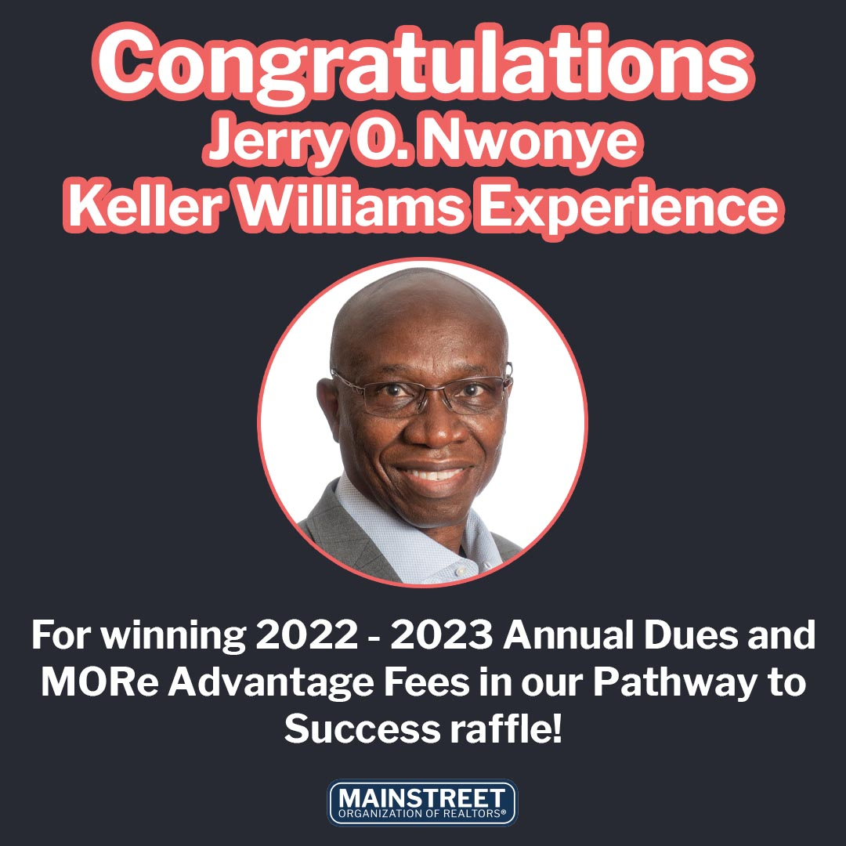
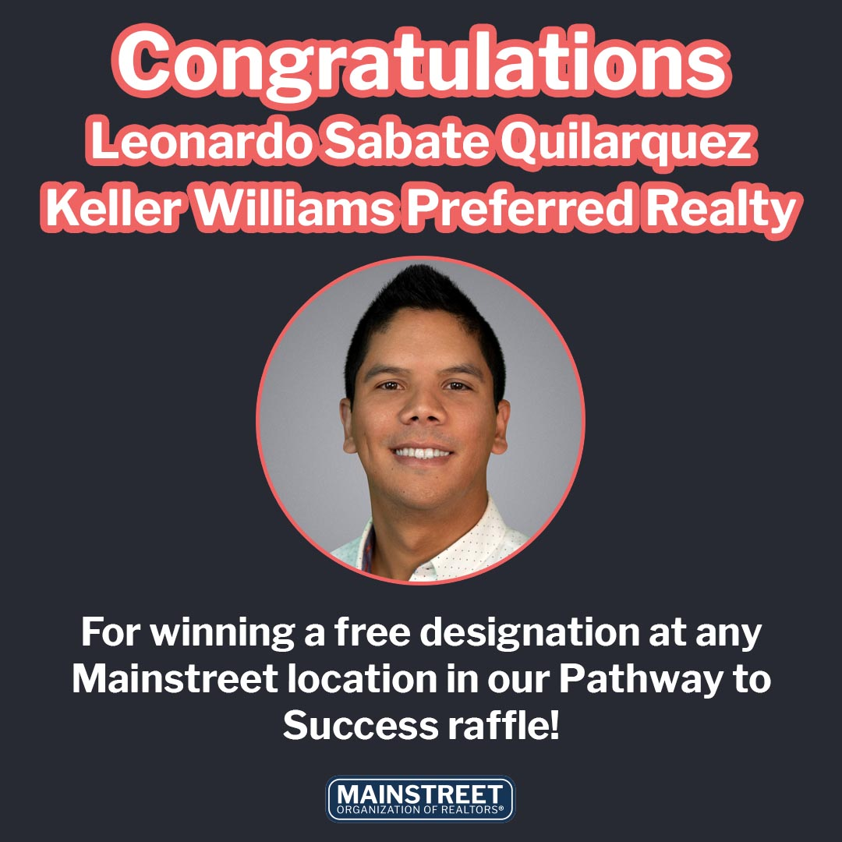
CONGRATULATIONS! 2022 Pathway to Success Winners
Everyone who completes the Pathway receives a Complimentary 3 HR CE Course

Slide 5
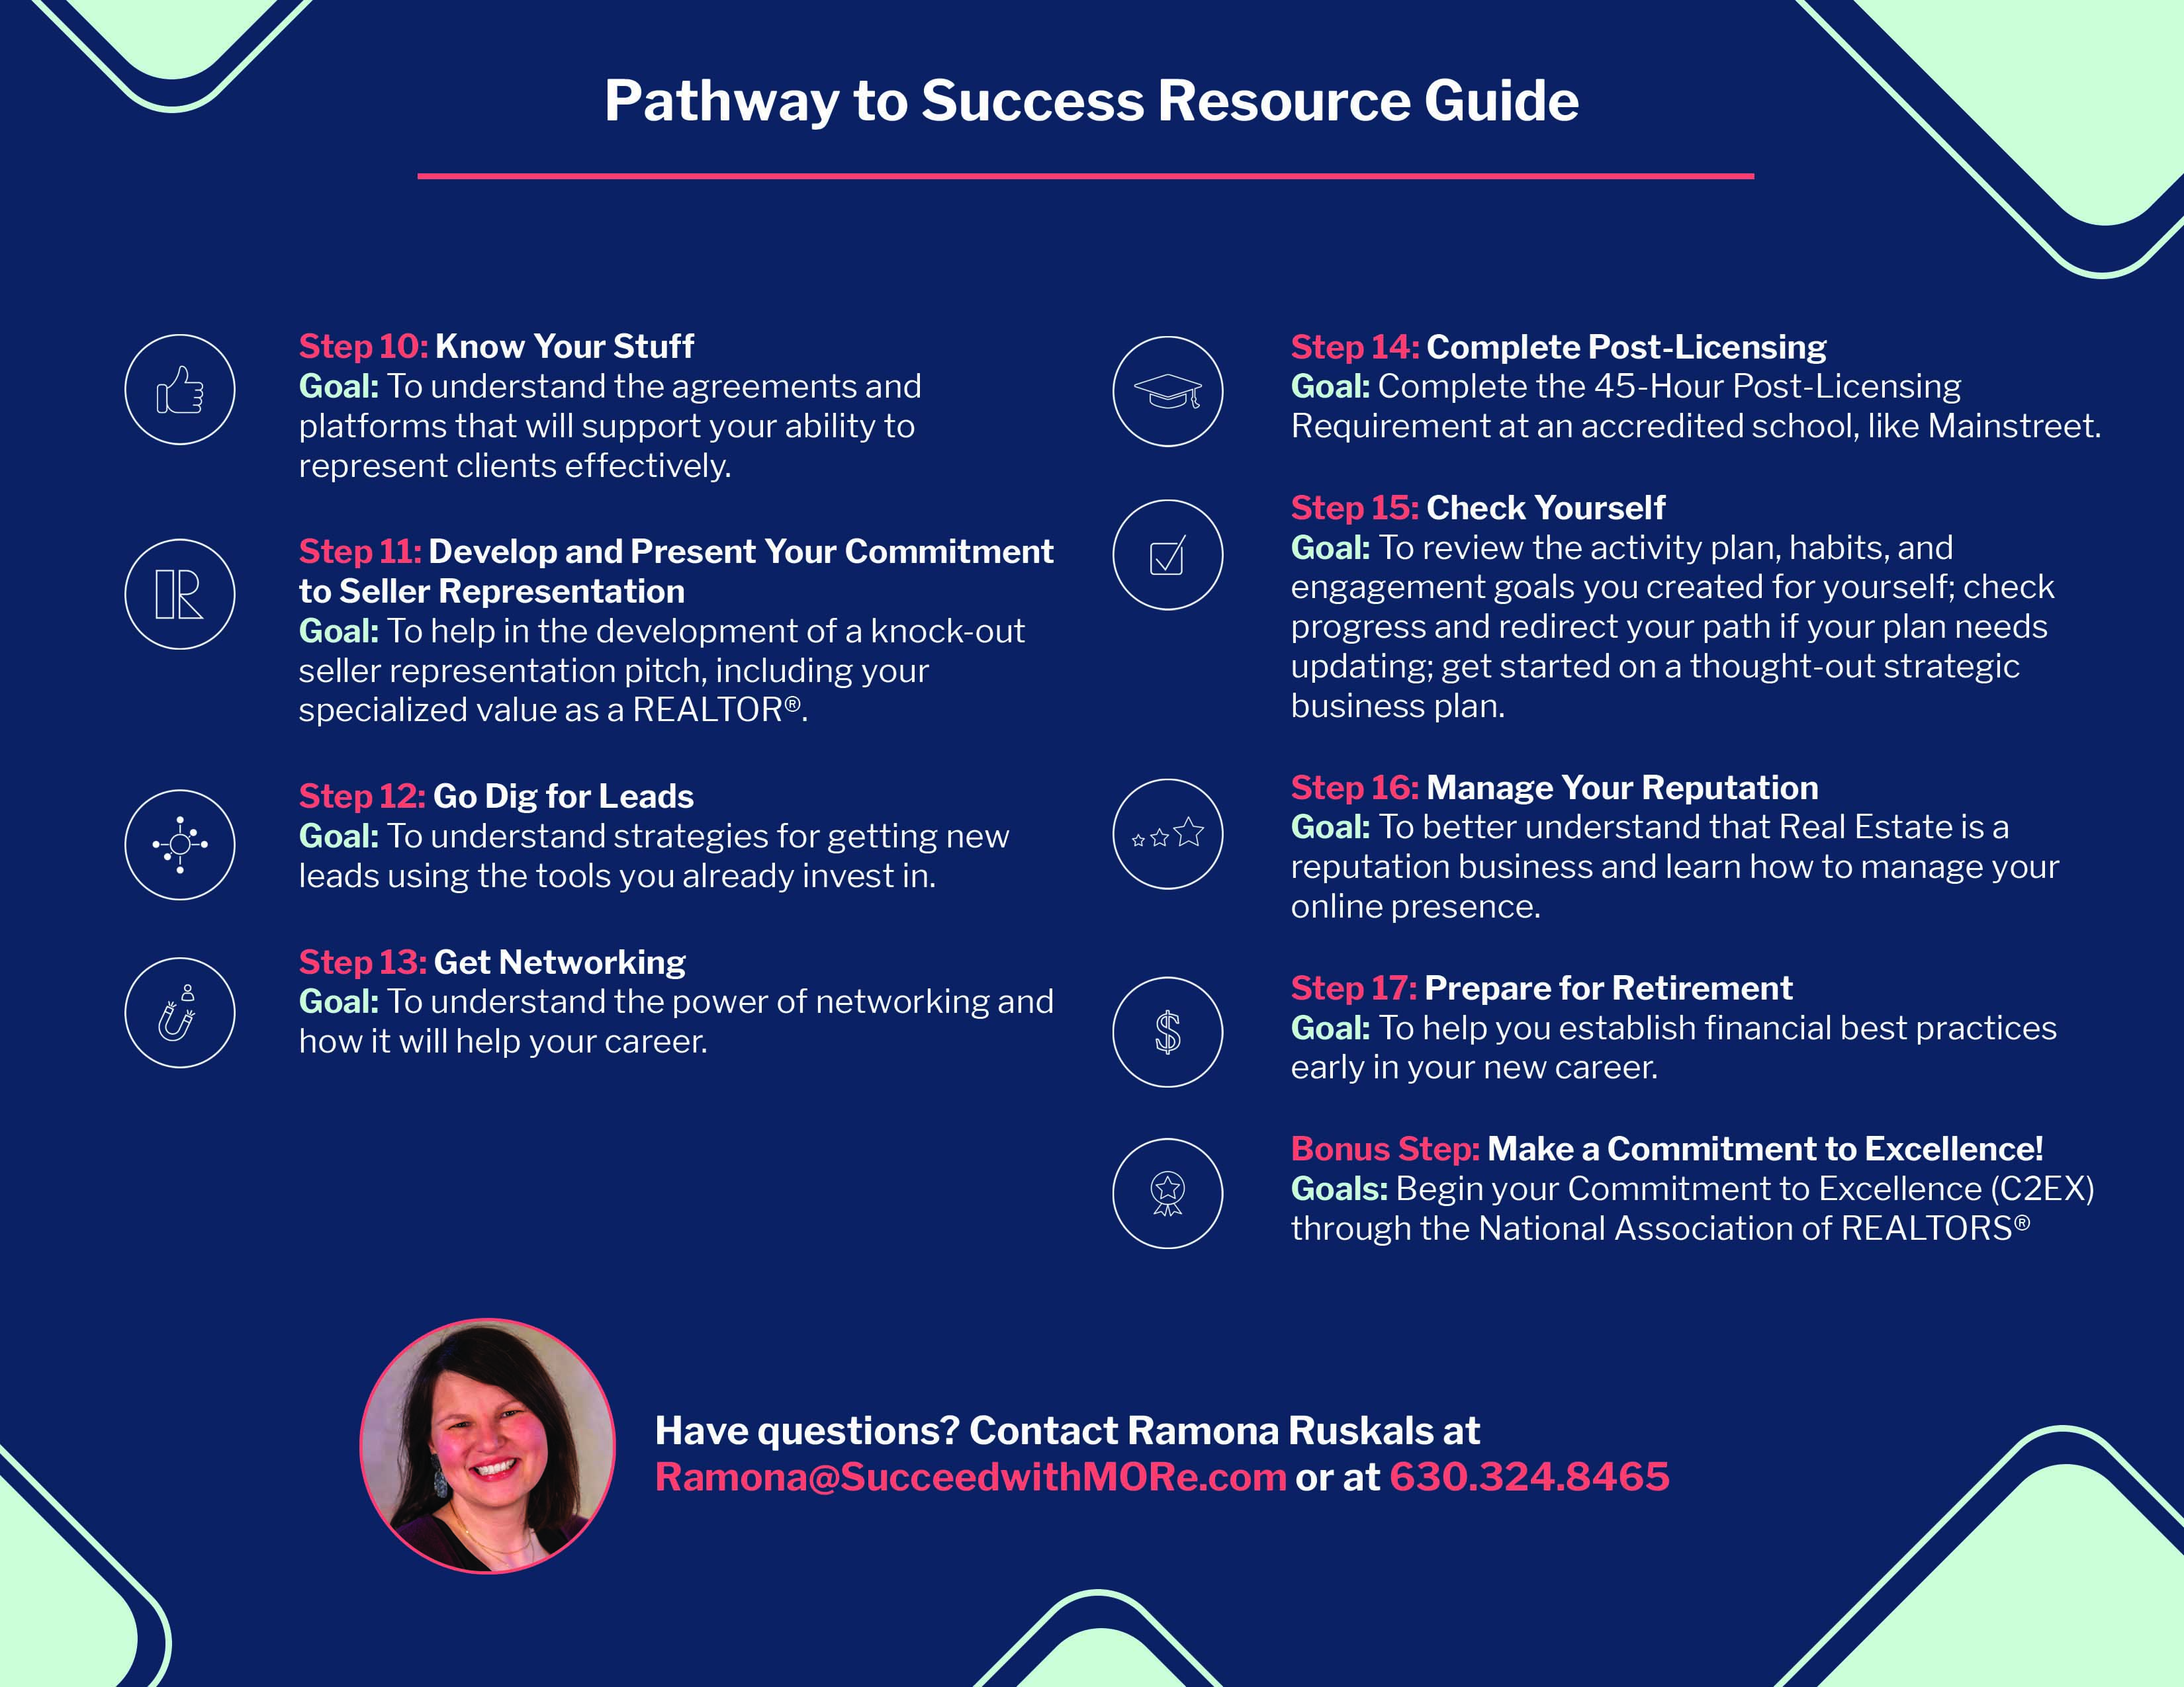
MEMBER BENEFIT: PATHWAY TO SUCCESS
Designed for Mainstreet Members in their 1st year of business!
SucceedWithMore.com/Pathway

Slide 6
COMMITMENT TO EXCELLENCE (C2EX)
Own your present while empowering your future with NAR’s award-winning Commitment to Excellence (C2EX) program. C2EX empowers REALTORS® to enhance and showcase your highest level of professionalism, while showing consumers you're the best in the business.
C2EX.REALTOR

Slide 7
UPCOMING COURSES AND EVENTS
8.10.22 REALTOR® Night at the Ball Game
8.18.22 Coffee & Conversation:
8.20.22 Mainstreet Senior Expo and Education
8.23.22 Propel: What Moves You? Tech Event
8.25.22 Brokerage Forum
8.26.22 Taste of India Lunch & Learn
8.30.22 News & Brews: Community Expert
8.31.22 Instructor Development Training
SucceedWithMORe.com/calendar

