Slide 1
JUNE 2022
BROKER SLIDES

Slide 2
FORM UPDATE
The Illinois Residential Real Property Disclosure Act was updated, which therefore requires new listings taken after May 13th to use the updated form.
FAQ’s: Illinoisrealtors.org/wp-content/uploads/2022/05/2022-SDA-IMPORTANT-NOTICE.pdf

Slide 3
CODE OF ETHICS VIOLATIONS
Article 3-9 Unauthorized Access –
Mainstreet has collected $15,000 in fines in the first half of 2022.
Entering a scheduled appointment early or late and not communicating with the listing agent may result in a violation.
Article 12 Advertising –
Most violations reported are of Facebook marketing;
Failing to disclose firm name;
Failing to disclosed status as a real estate professional;
Misleading or deceptive framing of website;
Manipulating content;
Presenting other’s content without attribution or permission.

Slide 4
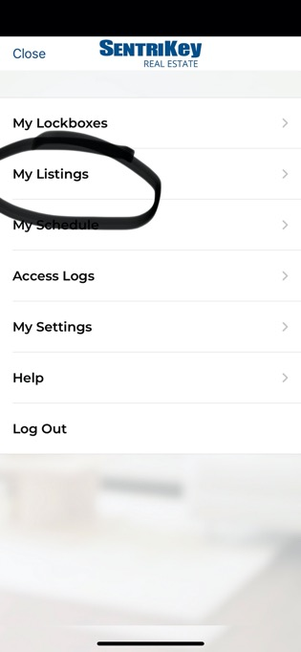
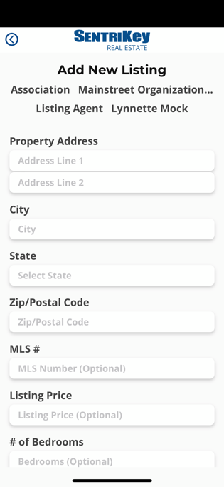
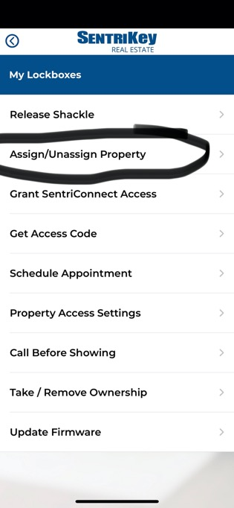
SENTRILOCK
Did you know that you can assign a lockbox to a Private Listing Property?

Slide 5
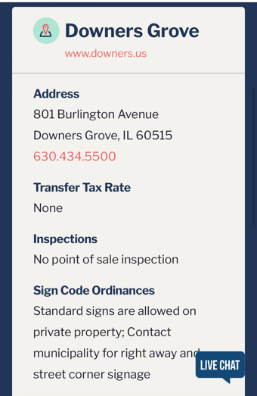
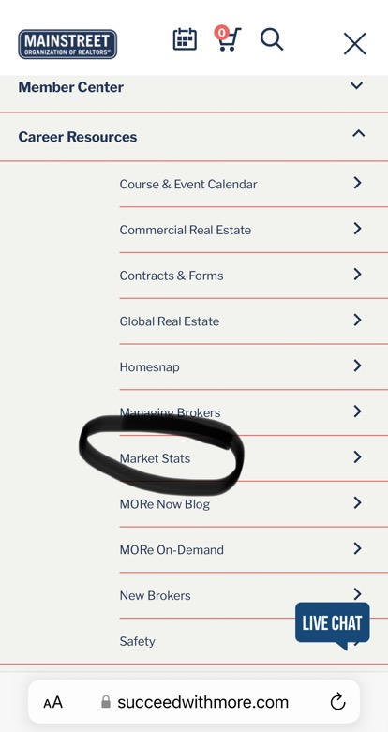
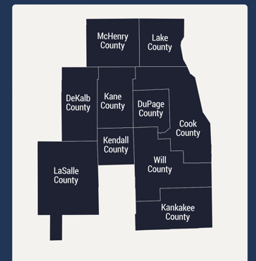
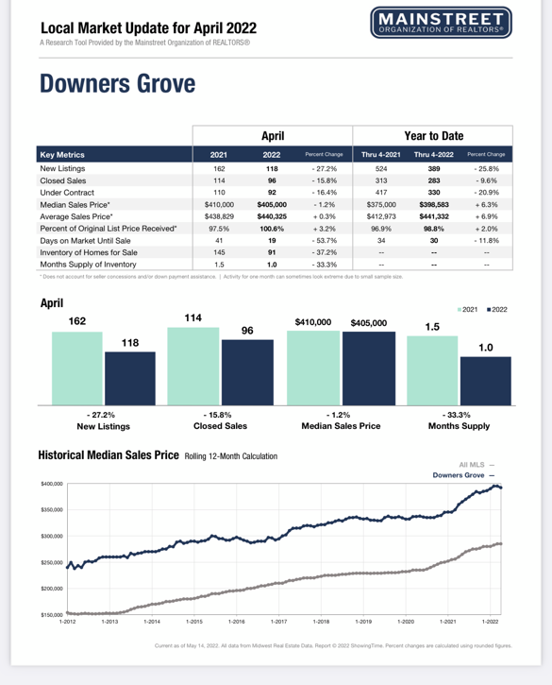
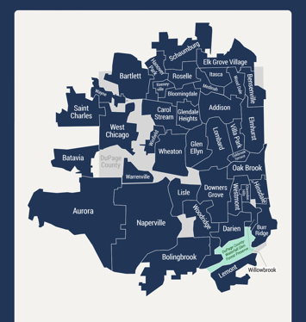
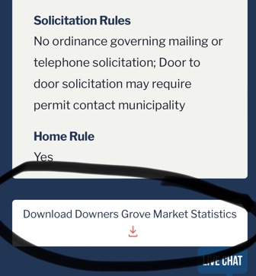
MEMBER BENEFIT - MORe MUNICIPAL DATA
Get the latest information on transfer taxes, solicitation, sign code ordinances, inspections, and home rule.

Slide 6
UPCOMING COURSES AND EVENTS
6.24.2022
Lake County: Understanding Assessments and Taxes
7.21.2022
Coffee & Conversation: Credit Repair
7.28.2022
Financing Green Energy for Commercial Property
SucceedWithMORe.com/calendar

