Slide 1
MARCH 2022
BROKER SLIDES

Slide 2
CAPITOL CONFERENCE
March 28th & 29th
RPAC Major Investors & YPN Members
One bus leaving from Downers Grove on Monday, March 28th and returning on Tuesday, March 29th.
Hotel accommodations are available for
$131 a night.
Registration: bit.ly/ypnmicapcon
Capitol Conference 1 Day Event
March 29th, 2022
No bus – carpooling is encouraged
Breakfast begins at 7:30 a.m. in Springfield and the program concludes at 2 p.m.
Registration: bit.ly/22capcon

Slide 3
SENTRILOCK
SentriCard phased
out on 3.1.2022
SentriKey Real Estate App can help make sure you stay connected. Here’s how:
For Bluetooth® Boxes: A good practice is to update your SentriKey Real Estate Mobile App credentials each day. Whether you’re a listing agent, showing agent, or an affiliated user, before you leave home or the office, launch the SentriKey Real Estate app on your mobile device. By authenticating, your credentials are good for 24 hours. When interacting with the SentriLock REALTOR® Bluetooth® Lockbox, it requires only a Bluetooth® connection to open the key door, even if you’re out of cell-service coverage.
For Non-Bluetooth® Boxes: If you’re going to a showing in a remote area and that listing isn’t using a Bluetooth® lockbox, we have a solution for you, too. Success is achieved by using the My Schedule function in the SentriKey Real Estate app. This is done either by the listing agent creating the appointment directly in the SentriKey Real Estate system, or through leveraging our integrations with other third-party showing services. When the showing is scheduled, and the SentriKey Real Estate app detects low or no cellular coverage, you’ll be presented with a Mobile Access Code in the SentriKey Real Estate app. No card needed, no Bluetooth® needed!

Slide 4
APRIL IS FAIR HOUSING MONTH
Complete FAIRHAVEN by April 30th and be entered into a drawing to win Apple AirPods!
Join us every Wednesday in April at 9th a.m. via zoom for a Fair Housing Discussion New topic every week: SucceedwithMORe.com/calendar

Slide 5
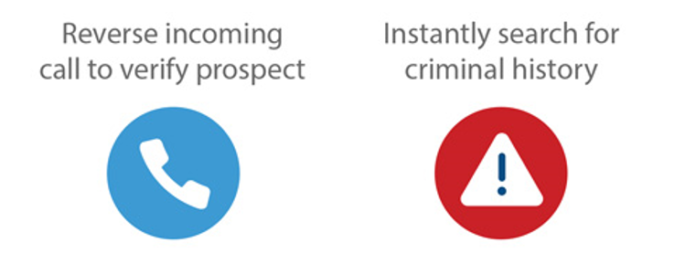
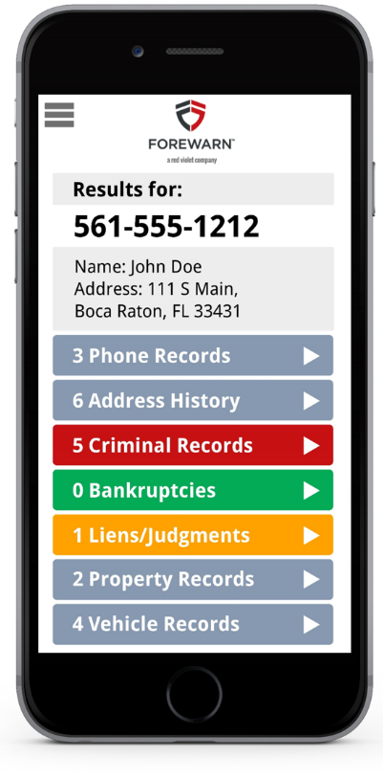
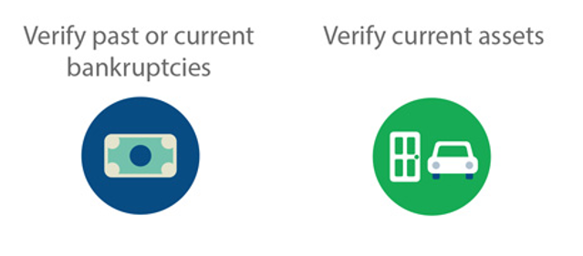
MEMBER BENEFIT: FOREWARN
Getting Ahead of the Risk with FOREWARN:
Proactive Safety - Instantly Know Who You Are Working With
Using only the incoming phone number, FOREWARN can positively identify over 90% of prospective buyers. With additional information, over 98% of the population can be identified.
Verify criminal history.
Verify financial risks (bankruptcies, liens, judgments).
Verify current property ownership.
Agents can properly plan for showings with a higher level of confidence.
SucceedwithMORe.com/FOREWARN
Notes:
Unlimited usage and tech help is for hardware and software issues.

Slide 6
UPCOMING COURSES AND EVENTS
Capitol Conference in Springfield 3.29.2022
PSA: Pricing Strategy Advisor Certification 4.01.2022
20 under 40 Applications Due 4.04.2022
Senior Exemptions: Understanding/Appealing Taxes 4.04.2022
Commercial Lunch & Learn: Asset Management 4.06.2022
Microaggressions: Words Matter 4.06.2022
Book Club: The Person YOU Mean to Be 4.13.2022
Fair Housing Testing Still Matters 4.20.2022
Coffee & Conversation: Navigating Pronouns 4.27.2022
Continuing Education Courses All Month
SucceedWithMORe.com/calendar

