Slide 1
MAY 2022
BROKER SLIDES

Slide 2
MAINSTREET COMMITTEE’S
Affiliate Advisory Group ~ Broker/Lawyer ~ Citation Panel ~ Commercial Alliance
Consumer Outreach Task Force ~ Diversity, Equity, & Inclusion ~ Education Advisory Group Global ~ Golf Advisory Group ~ Good Neighbor Award Government Affairs ~ Grievance Member Benefit Advisory Group ~ Professional Standards ~ RPAC ~ Senior Services
Young Professionals Network (YPN)

Slide 3
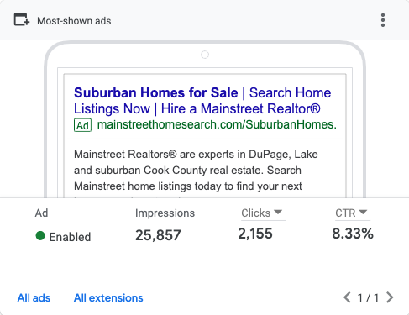
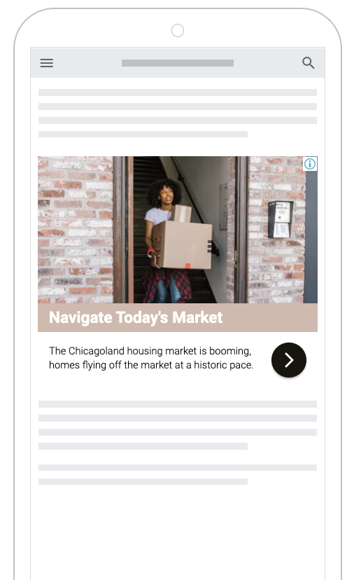
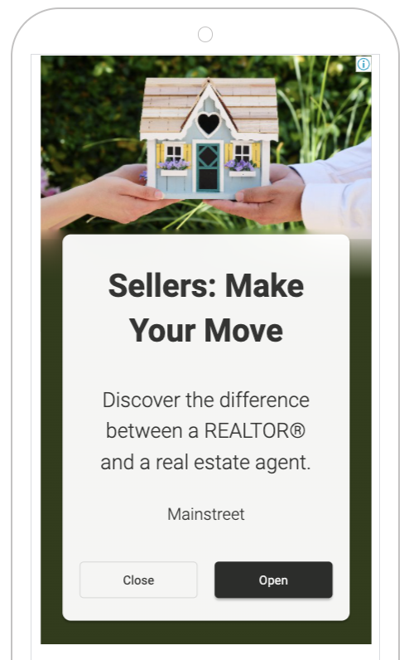
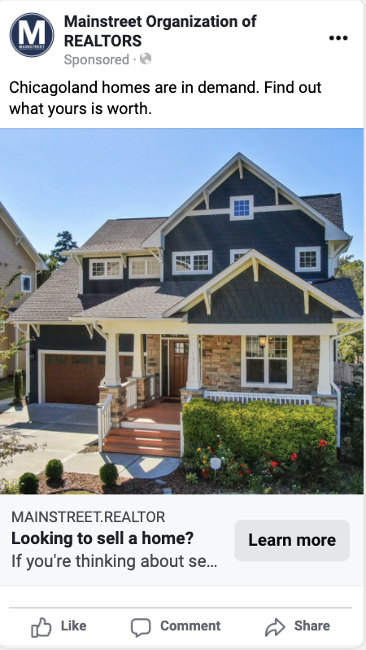
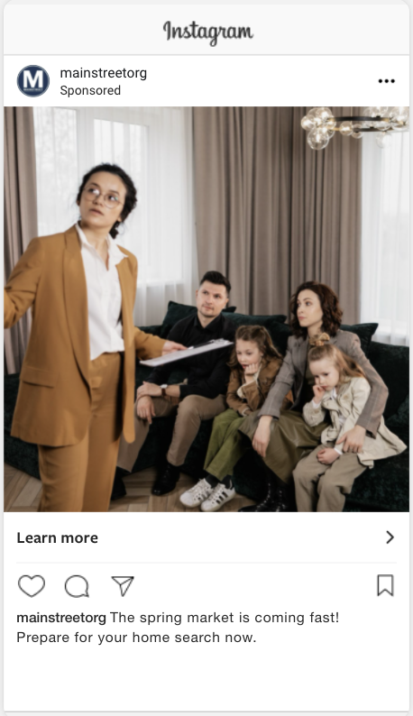
2022 MAINSTREET CONSUMER CAMPAIGN
Podcast Buyer Spots
Mainstreet working for you!
Google Display Ads
Search Ads
Facebook Ads
Podcast Ads

Slide 4
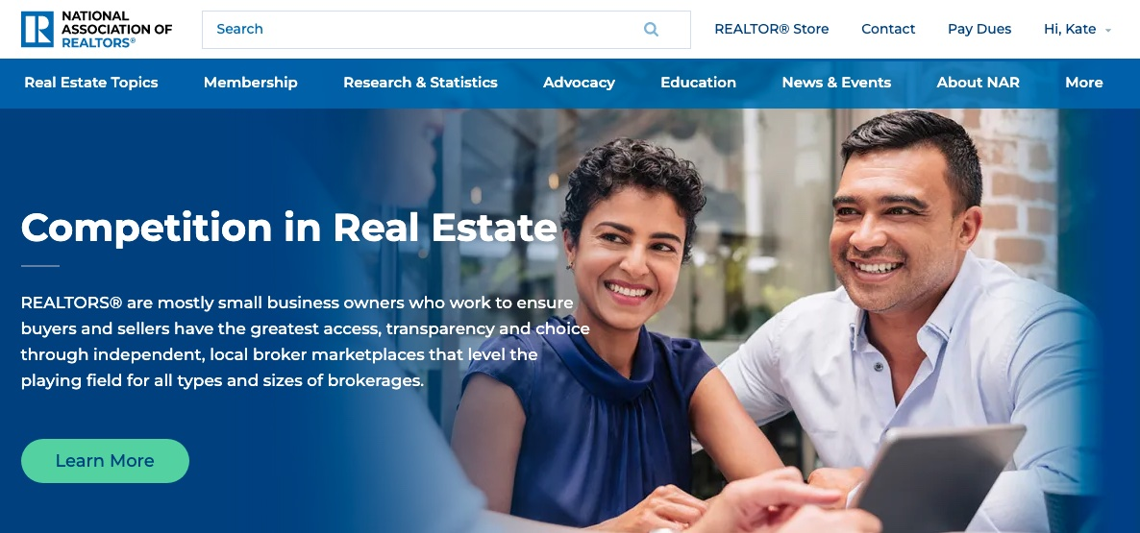
competition.realtor
Fostering Competition
Independent, local broker marketplaces create highly competitive markets that are friendly to small businesses and new market entrants.
Sellers receive access to the largest pool of potential buyers in one, centralized location.
Private Listing Network (MRED) and Clear Cooperation Policy (NAR) provides transparency and fairness by eliminating “pocket listings” advertised to small or particular groups of consumers.
Consumer Access & Opportunity
Local broker marketplaces ensure equity, transparency and market-driven pricing options for the benefits of home buyers and sellers.
Education on how real estate commissions work.
Homebuying process primer.
REALTORS® as Champions
REALTORS® are everyday working Americans who champion homeownership and property rights for the communities they serve.
Code of Ethics, consumer protection
Committed to building and enhancing the communities they serve and fight for fair housing.

Slide 5
PODCAST
A New REALTOR®-to-REALTOR® Podcast
Listen Now at
magazine.realtor/drive

Slide 6
COMMITMENT TO EXCELLENCE
Differentiate yourself in your community – compete in Mainstreet’s 2022 C2EX challenge!
Earn your endorsement; increase marketability; and optimize opportunities to best serve clients and position yourself as a leader in the community!

Slide 7
MAINSTREET MEMBER BENEFITS
Additional Mainstreet Benefits:
C.E. with Top Instructors
On-Site C.E. at your Office
Forms & Contracts
Monthly Broker Slides
Leadership
Ombudsman
Top Producer Awards
Signature Events

Slide 8
UPCOMING COURSES AND EVENTS
Accessibility & Safety: Housing an Aging Society 6.06.2022
Dr. Yun in June (Virtual) 6.07.2022
Commercial Boot Camp (ACP Certification) 6.07.2022
Mainstreet Volunteer Day 6.08.2022
Margery Shinners Memorial Golf Outing 6.15.2022
Coffee & Conversation 6.16.2022
News & Brews: Position Yourself as a Community Expert 6.21.2022
Commercial Workshop 6.23.2022
Xplode Three Hour Intensive Workshop 6.24.2022
MRED Training is back LIVE at all 4 Mainstreet Locations!
SucceedWithMORe.com/calendar

