Slide 1
November 2022
BROKER SLIDES

Slide 2
LICENSE LAW
On Demand Showing Companies
It is important to recognize that while there are many companies within the Real Estate industry that may save you time and money, they are not always compliant with the Illinois Real Estate License Act. Currently, there is a service in our area that allows you to request other Real Estate licensees show homes to your buyer client on your behalf for a fee. While this service might be efficient and assist your clients, agency and compensation payment requirements in the law may restrict this service. If you have any questions about this or any other platform, we are here to help. Contact our Professional and Ethical Practices Department at 630.324.8400.

Slide 3
SENTRILOCK
Display of Lockbox Location Feature Release 11/8/22 It can be difficult for a showing agent to find the lockbox at multi-family dwelling or condo. Listing agents can upload a photo and description of the lockbox location in the SentriKey® Real Estate app or website*. Photos can be taken with your phone or uploaded from your photo library. Navigate to the "My Listings" tab to use this feature. Showing agents can view the lockbox location image in the property description.

Slide 4
RPAC MEGA RAFFLE
There will be 12 drawings.
Raffle runs November 1 -30
4 - $250 Drawings held on Nov. 4th
5 - $500 Drawings held on Nov. 11th
$1000 Drawing held on Nov. 18th
$2500 Drawing held on Nov. 23rd
$5000 FINAL drawing held on Nov. 30th
Tickets are $50
Even if you win, tickets will always go back into the next drawing.
Link to purchase tickets:
https://www.illinoisrealtors.org/advocacy/rpac/

Slide 5
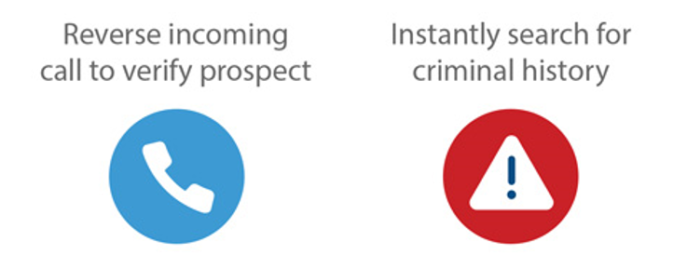
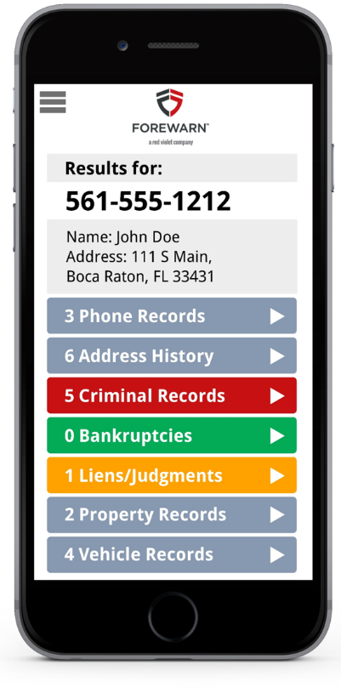
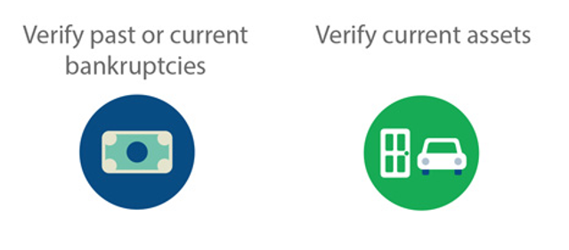
MEMBER BENEFIT: FOREWARN
Getting Ahead of the Risk with FOREWARN:
Proactive Safety - Instantly Know Who You Are Working With
Using only the incoming phone number, FOREWARN can positively identify over 90% of prospective buyers. With additional information, over 98% of the population can be identified.
Verify criminal history.
Verify financial risks (bankruptcies, liens, judgments).
Verify current property ownership.
Agents can properly plan for showings with a higher level of confidence.
SucceedwithMORe.com/FOREWARN
Notes:
Unlimited usage and tech help is for hardware and software issues.

Slide 6
UPCOMING COURSES AND EVENTS
12.1.22 Commercial Boot Camp
12.5.22 12-HR Broker Management
12.6.22 Welcome to the Mobile Office
12.6.22 YPN Ugly Sweater Fundraiser
12.7.22 Market Report on Canadian Markets
12.9.22 Color Workshop for REALTORS®
12.12.22 12-HR Broker Management
12.15.22 Coffee & Conversation
12.16.22 CSC: Certified Staging Consultant
SucceedWithMORe.com/Calendar

