Slide 1
September 2022
BROKER SLIDES

Slide 2
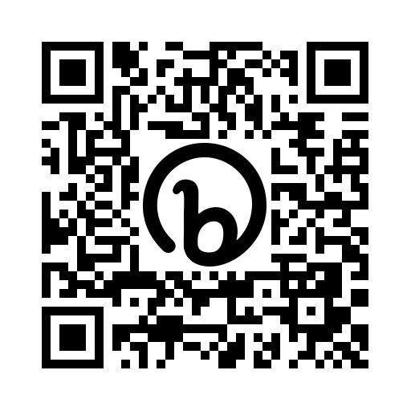
TELL US YOUR WHY?
Want to meet Jarrett Payton? How about WINNING a free marketing video? Both could be yours!
Record and post a 1-2 minute video about why you’re a REALTOR® on social media.
Tag Mainstreet Organization of REALTORS® using the hashtag #MainstreetREALTORS by September 30th.
One lucky member will win an exclusive opportunity to meet and introduce Jarrett Payton prior to his keynote presentation (photo opp included) on October 13th and a free marketing video using Mainstreet’s professional videographer and studio.

Slide 3
CODE OF ETHICS
Mainstreet Offers You a Better Way to Resolve a Dispute
Even REALTORS® who are committed to high standards of conduct occasionally have honest business disputes with other professionals, clients, or customers.
Professionalism Hotline:
When you have ethics, transactional, or professional standards questions, you need quick answers. The Mainstreet Professionalism Hotline is staffed by trained experts who are standing by to help members and consumers with questions related to real estate transactions.
Ombudsman Program:
Sometimes disputes just need facilitated conversation to get both parties on the same page. Our Ombudsman program offers an option for resolution that can help facilitate and bride conversations between parties in conflict. This peer-driven process is confidential and allows you to bypass a lengthy complaint process.
Our Ombudsman Team is comprised of members and REALTORS® who have gone through mediation training and are well-versed on the Code of Ethics and the Professional Standards Process.
Call 630.324.8400 and select the Professional & Ethical Practices option.
Ethics, Mediation, & Arbitration:
If you’ve tried the hotline and our Ombudsman Team, or believe you have a more serious complaint or violation to report, you can file a complaint by choosing to file a formal complaint www.simpleonlinestandards.com/sos

Slide 4
SENTRILOCK
It’s REALTOR® Safety Month! Protecting your data is extremely important. That's why, effective Tuesday, September 13th, SentriLock is implementing an extra layer of security to the SentriKey® Real Estate website and SentriKey® Real Estate mobile app by modifying the process for when you need to change your PIN.
Sept. 13th Members receive an email from SentriLock
Members required to update the SentriKey RE mobile app before use
Members required to change PIN
Re-enable biometrics if used

Slide 5
MORe Advantage Fees
MORe advantage fees due Sept. 24th
Reminders are sent from Accounting@SucceedwithMORe.com
Late fees assessed on Sept. 28th
Suspensions for non-payment occur on Oct. 3rd

Slide 6
MEMBER BENEFIT: TECH HELPLINE
There's no need to sign up for anything, your account is attached to your active Mainstreet REALTORS® membership and is ready to be used when you need it. When you need assistance the process is simple:
Contact Tech Helpline via phone, live chat or email
They’ll verify your active Mainstreet REALTORS® membership
They’ll troubleshoot the problem or provide answers to your questions
Notes:
Unlimited usage and tech help is for hardware and software issues.

Slide 7
UPCOMING COURSES AND EVENTS
10.3.22 12-Hr Broker Management
10.3.22 Working with Housing Vouchers
10.12.22 Team Strategies for Performance
10.13.22 Creating an Impact in Your Community
10.13.22 Oktoberfest
10.17.22 Market Analysis for Commercial Investment Real Estate
10.17.22 Seller Representative Specialist Designation
10.20.22 Coffee & Conversation: Healthcare
10.31.22 Certified International Property Specialist Designation
SucceedWithMORe.com/calendar

