Slide 1
REALTOR® Safety

Slide 4
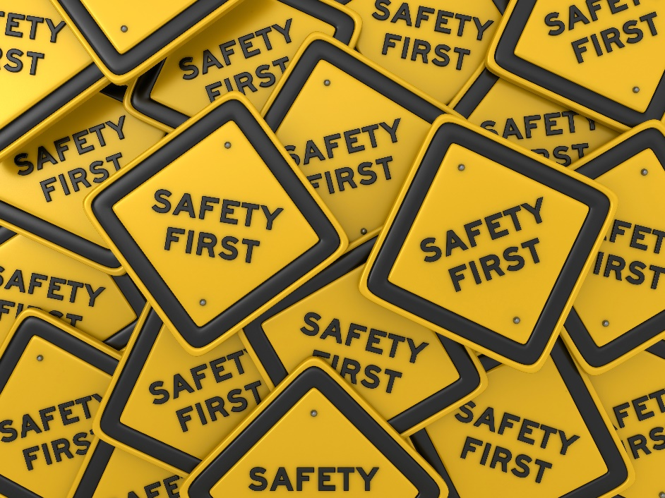
Safety Tips to Empower REALTORS® in the Field
How can agents like you stay safe on the job? Make personal safety a priority and put these safety tips for REALTORS® into action.

Slide 5
Always listen to your gut and trust your instincts.
If something feels out of place or wrong, it probably is. Your instincts are there to help keep you safe, and you have to trust them when something triggers an uneasy feeling.

Slide 6
Stay alert and always let the client walk first into each room.
Be aware of your surroundings when working with others. Ask yourself: Where are all the possible exits? Are there cameras around? Who are the neighbors? These details are crucial to maintain control over a potentially dangerous situation.

Slide 7
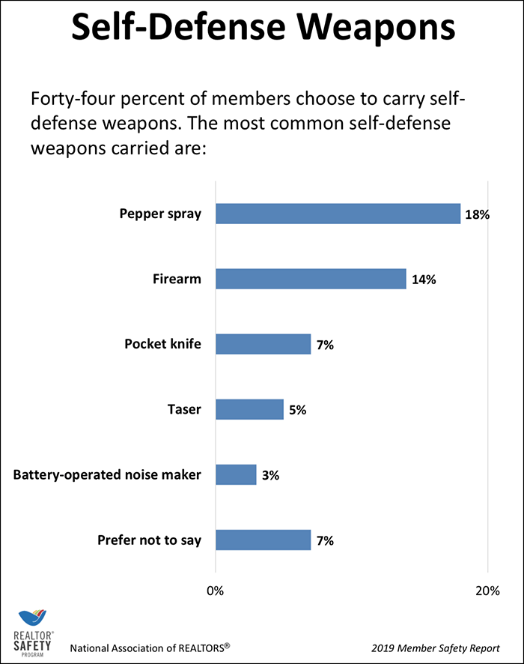
Carry a self-defense weapon. Know your options and know the rules.
You have several options when it comes to self-defense weapons. Pepper spray is the most-used among REALTORS® in general, according to NAR. Eighteen percent of REALTORS® say they carry pepper spray.

Slide 8
Tell co-workers and family where you are at all times.
Agents should keep colleagues and family informed about what you’re doing, who you’re with, and where you are — and not just when you feel nervous about a specific meeting or client.

Slide 9
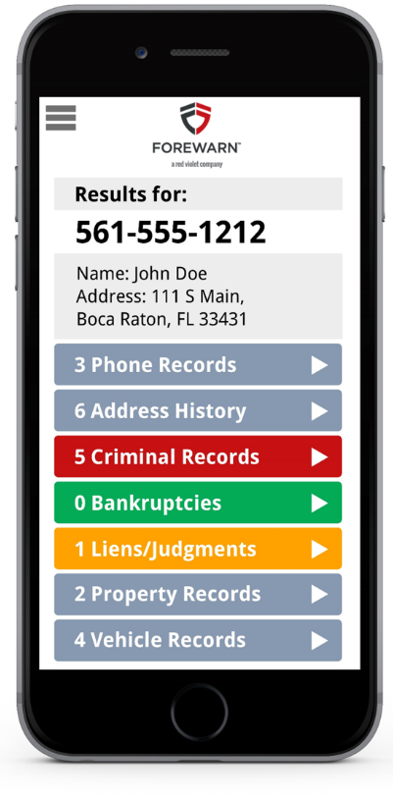
Use technology and tools to prioritize safety.
In addition to person-to-person communication, there are a number of tools and apps that can help you prioritize personal safety on the job. Including Mainstreet’s No-Cost Member Benefit: FOREWARN.
SucceedwithMORe.com/FOREWARN

Slide 10
Educate yourself through training and self-defense classes.
Professional safety training is a great way to ensure continual safe practices. Look for C.E. courses taught by Mainstreet Certified Instructors.
SucceedwithMORe.com/calendar

Slide 11
Create a safety plan and get your office involved.
You might know agents who don’t like to admit that there’s a problem so they keep quiet about any safety concerns. You might be one yourself! But the lack of candid conversation around agent safety helps no one. The dangers of being a real estate agent are real, and ignoring them won’t make the risks go away.

Slide 12
Be notified.
Most municipalities have established safety text alert systems in their communities. We encourage you to sign up in the communities where you do business.

Slide 13
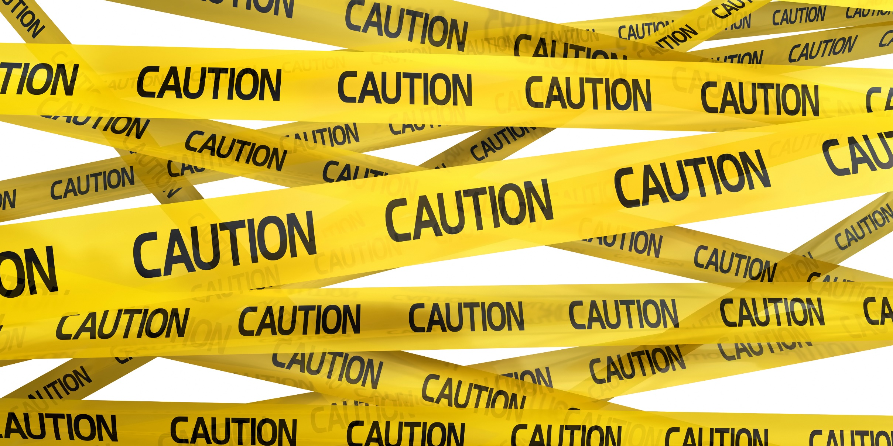
Bottom line: Agents should be vigilant and intentional about personal safety.
Safety will be an issue for real estate agents as long as you’re regularly meeting strangers in empty houses. While there’s no way to guarantee that malicious people will stop targeting agents, you can reduce the chances of having dangerous encounters with an intentional approach to personal safety, by staying alert at all times, using the tools and safety devices available to you, and making self-defense training a priority.

Slide 14
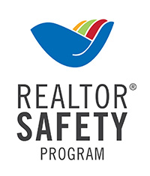
Additional resources:
REALTOR® Safety Program
Knowledge. Awareness. Empowerment. These are the core components of REALTOR® Safety. And helping our members understand the risks they face can mean the difference between life and death.
nar.realtor/safety
Webinars on REALTOR® Safety, presented by industry experts
onlinelearning.realtor/A/Category/SafetyProgram
Mainstreet’s Website
succeedwithmore.com/safety

