Slide 1
HOUSING CHOICE VOUCHER PROGRAM
Presented by:
  Annette Panzek
  AHWD, ABR, CNC, GRI, SFR, SRS

Slide 2
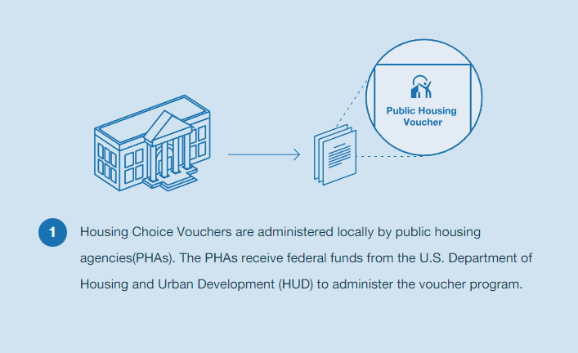

Slide 3
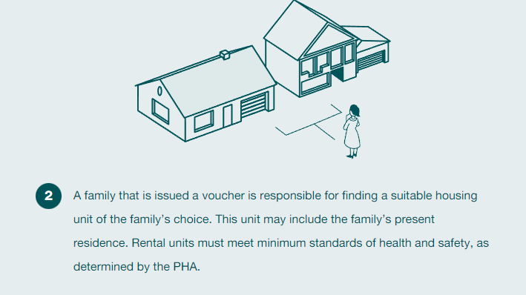

Slide 4
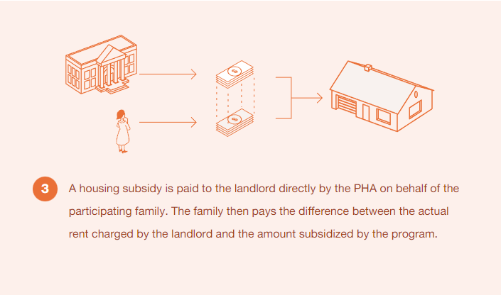

Slide 5
Qualifying
Maximum household income < 80% of the area median income
Each metro area and/or county has own income limits
Voucher holder may have qualified for the program in one area but no longer qualify in another if the income limits are lower
The 2022 Chicago-Joliet-Naperville Metro FMR maximum household income may not exceed:
Household Size | 1 | 2 | 3 | 4 | 5 | 6 | 7 | 8
Maximum Income | $58,350 | $66,700 | $75,050 | $83,350 | $90,050 | $96,700 | $103,400 | $110,050
https://www.huduser.gov/portal/datasets/il/il2020/select_Geography.odn

Slide 6
Benefits for Landlords
Assurance of prompt payment of subsidy each month.
Decreased vacancy rates and delinquencies.
Reduced turnovers and related expenses.

Slide 7
Benefits for Landlords
No-cost property inspections.
Opportunity to upgrade property and rental structure.
Ready pool of motivated applicants for vacancies

Slide 8
Public Housing Authority (PHA)
Oversees the programs
Conduct inspections
Approves leases

Slide 9



AREA PUBLIC HOUSING AUTHORTIES
Housing Authority of Cook County: https://thehacc.org/
DuPage Housing Authority: https://www.dupagehousing.org/
Kendall Housing Authority: https://www.dupagehousing.org/
Housing Authority of Elgin: https://www.haelgin.org/

Slide 10




AREA PUBLIC HOUSING AUTHORTIES
Housing Authority of Joliet: https://www.hajoliet.org/
Chicago Housing Authority: https://www.thecha.org/
Lake County Housing Authority: https://www.lakecountyha.org/
Aurora Housing Authority: https://auroraha.com/

Slide 11

Tenant Selection
PHA does not screen voucher holders for their suitability as tenants

Slide 12
Request for Tenancy Approval
Landlord Screens Tenant
Credit, etc.
Landlord Completes RTA Package
Packet
Lease
Approval by PHA
RTA to PHA
7-21 calendar days
References
Background
Ownership
Banking
Application
PHA Screens Landlord

Slide 13
Screening Tenants
Landlord may screen the tenant in any way they screen other tenants
Reasonable application fees may be charged, provided they are charged to all applicants

Slide 14

FAIR HOUSING CONSIDERATIONS
Use the same criteria & exceptions for all other applicants
Landlords should be careful how they process income requirements
Having requirements for income that would make it impossible for a housing voucher recipient to qualify could be considered a disparate impact on this protected class and therefore be discriminatory

Slide 15
FAIR HOUSING CONSIDERATIONS
Arrest Record is a protected class
Convictions must be related to harm to person or damage to property and considered a serious offense
Screening for convictions should not overreach more than 3 years
Cook County = Just Housing Amendment

Slide 16
Landlord Process
RTA (Request for Tenancy Application) Approved
Tenant pays security deposit directly to Landlord
PHA Conducts Inspection of Property
Rent Offer Made to Landlord
Paperwork Signed

Slide 17

Inspection Process
PHA schedules Initial Housing Quality Standards (HQS) inspection
5-10 business days after unit owner screening is completed
Unit owner or property manager must be present at the inspection
Property should be vacant with no personal property inside except appliances being conveyed with the unit

Slide 18
Inspection Process
Utilities on
All areas of the unit that the tenant will have access to must be available to the inspector
Attic, crawlspace, utility boxes, and garages should be accessible to the inspector.

Slide 19
Inspection Process
Not looking at cosmetic items unless it poses a health or safety risk
Floor coverings, paint (exception lead paint hazards), blinds or other window coverings, landscaping, or décor.

Slide 20
Inspection Process
All units must have the following rooms:
  Living Room
  Kitchen
  Bathroom
  A sleeping area (in a studio or efficiency this would be the living room)

Slide 21

Rent Determination
PHA determines rent with the property owner & computes amounts the tenant and PHA will pay.
Rent to Landlord may not exceed Payment Standard for area (see payment standard charts)
If Tenant paying any utilities, then Approved Rent may be reduced (see utility allowance charts)
This Photo by Unknown Author is licensed under CC BY-ND

Slide 22
Tenant
PHA
Rent & Utilities

Slide 23
Rent Determination
Tenant pays 30-40% of adjusted monthly income for rent and a utility allowance = Total Tenant Payment (TTP)
PHA pays the remaining rent and utility allowance costs via a rental subsidy in the form of a Housing Assistance Payment (HAP) to the Landlord
This Photo by Unknown Author is licensed under CC BY-ND

Slide 24

Lease paperwork
Landlord & PHA sign Housing Assistance Payment (HAP)
Landlord & Tenant sign One Year Lease (12 Months)
HUD Issued Tenancy Addendum Required
Required Property Disclosures Signed
  Lead Paint (built prior to 1978)
  Radon (if elevated & NOT mitigated)

Slide 25
Lease paperwork
Tenant pays security deposit/move-in fee directly to Landlord
Tenant pays their portion of 1st month’s rent directly to Landlord
1st PHA payment may be up to 3 weeks later then every month at beginning of month

Slide 26
PHA issues voucher
Tenant chooses a unit
PHA screens the property owner
PHA inspects the unit
PHA determines the rent
Tenant signs Lease
PHA signs HAP Contract
Tenant Moves In

Slide 27

Landlord’s Rights
Enforce the lease with their tenant
May terminate the tenancy for:
  Serious or repeated violation of the terms and conditions of the lease
  Violation of federal, state or local law
  Criminal activity
  Other good cause

Slide 28

Landlord’s Responsibility
May request a rent increase from PHA as of the anniversary end date of the HAP contract (capped by rent reasonableness)
60-day notice required to PHA & tenant of any increases, renewal, or termination of lease
Tenant is responsible for all damages to the unit (except normal wear & tear)

Slide 29
Landlord’s Responsibility
Comply with the Lease
Collect the tenant's share of the rent
Make timely repairs and keep the unit in good condition
Comply with federal, state, and local regulations, fair housing laws, and landlord-tenant laws
Permit inspections

Slide 30

Landlord May NOT
Accept any payment outside of the lease that is not approved in writing by the PHA
Accept any payment for “rent” of appliances or other items inside the unit unless approved in writing by the PHA
Allow any other individuals to occupy the property than those listed on the lease unless approved by the PHA

Slide 31
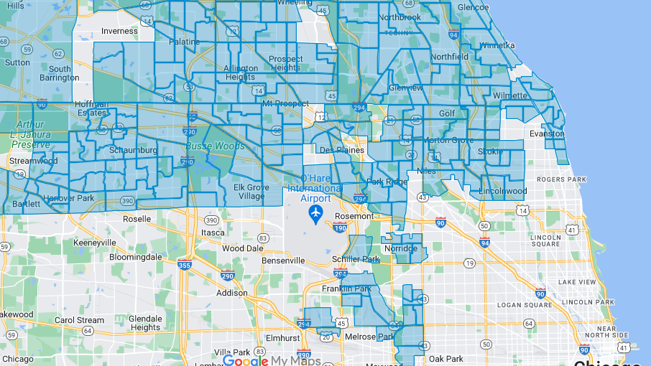
Mobility & opportunity areas
1st time Landlords
Designated zip codes
Higher rent possible
Landlord incentives
Check PHA website for list & qualifications

Slide 32


This Photo by Unknown Author is licensed under CC BY-NC
This Photo by Unknown Author is licensed under CC BY-NC

